Slide 1
First Principles Workshop
An introduction and hands-on tutorial with the
Quantum ESPRESSO
Introduction to Quantum ESPRESSO and Computer System
R. Saito group

Slide 2
What we will learn within today’s workshop
Quantum ESPRESSO = opEn-Source Package for Research in Electronic Structure, Simulation, and Optimization
http://www.quantum-espresso.org/
Today’s DFT menu:
Structural Optimization
Electronic Structures
Phonon Dispersions (if time allows)
Beyond “standard” DFT
(only some brief introduction, if time allows):
Wannier90: Quantum Transport, Thermoelectricity

Slide 3
QE Basic Installation and Its Companions
Linux
Windows
Mac OS X
sudo apt-get install quantum-espresso quantum-espresso-data
qe-5.3.0-32bit-serial.exe
Install VirtualBox for OS X
qe-5.3.0-64bit-serial.exe
Install Ubuntu ISO file
Do same step like Linux
(Ubuntu install method is the most convenient!)
(check your system,
32 or 64 bit!)
Alternative way: Fink + Install QE from source
How to run:
How to run: (in CMD)
How to run:
pw.x < input > output
pw.exe < input > output
pw.x < input > output
Molecule and Crystal Structure Visualization by Vesta or Xcrysden
Text Editor (WordPad, NotePad++, Gedit, Vi, Emacs, etc)
Plotting Software (Gnuplot, Grace, Origin, Excel, etc)

Slide 4
Linux Live with USB drive
is also a good way!
Quantum ESPRESSO
Persistent Live USB

Slide 5
Advanced information: requirements for
compiling QE (in real research work)
Software that we must have on our machines/servers/clusters:
Linux or Unix-like environments (shell and Make utility)
A working fortran-95 compiler (most “fortran-90” compilers are ok, “g77” is not)
A working C compiler (“gcc” is ok)
To run in parallel:
MPI (Message-passing Interface): parallel compiler (“mpif90” or similar scripts), run-time environment (“mpirun” or similar launchers)
OpenMP-capable compiler and autothreading mathematical libraries (for multi-core CPUs)

Slide 6
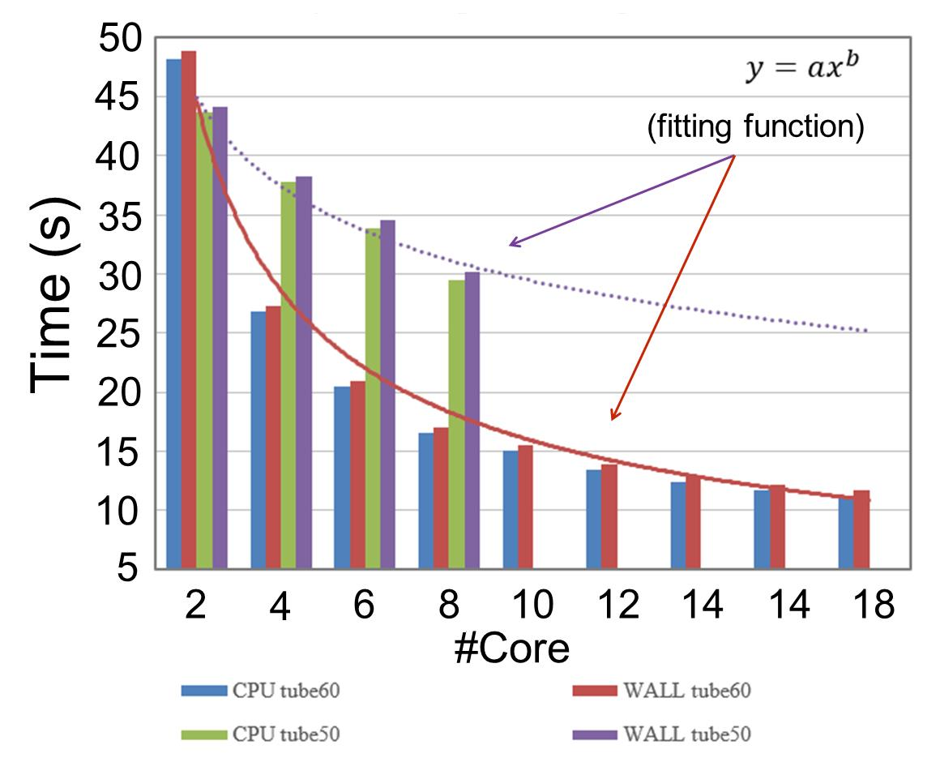
Example Running in Parallel System
Graphene SCF Calculation
Running with 1 core is often not sufficient, 10 cores may be enough

