Slide 1
First Principles Workshop
An introduction and hands-on tutorial with the
Quantum ESPRESSO
Quantum Espresso Hands-on
Tutorial
by N. T. Hung, A. R. T. Nugraha and R. Saito group
http://flex.phys.tohoku.ac.jp

Slide 2
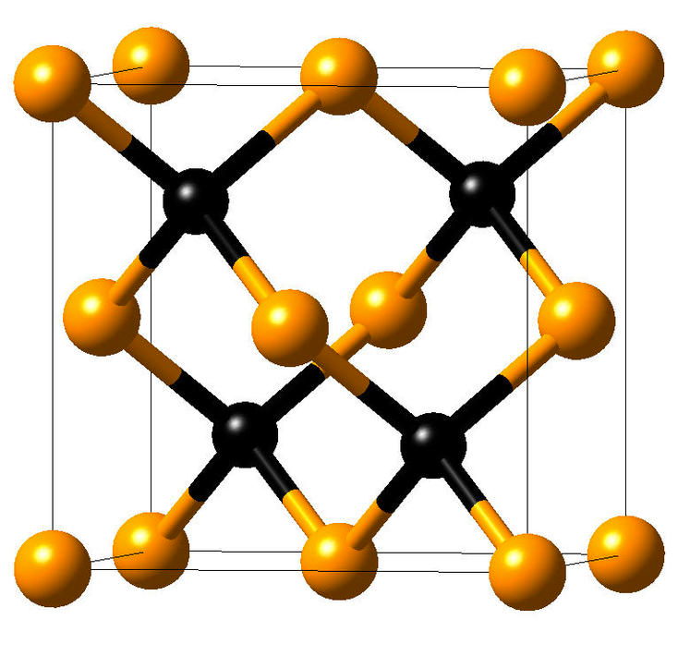
What we will do today
Hands-on #1: Total energy and relaxations for Silicon
Basic self consistent calculation (scf)
Convergence of total energy & plane waves cutoff (ecut)
Convergence of total energy & BZ sampling (k-point)
Lattice constant (vc-relax)
Files for practice
/silicon/
scf
ecut
Hands-on #1
k-point
vc-relax
rho
Silicon
dos
bands
phonon

Slide 3
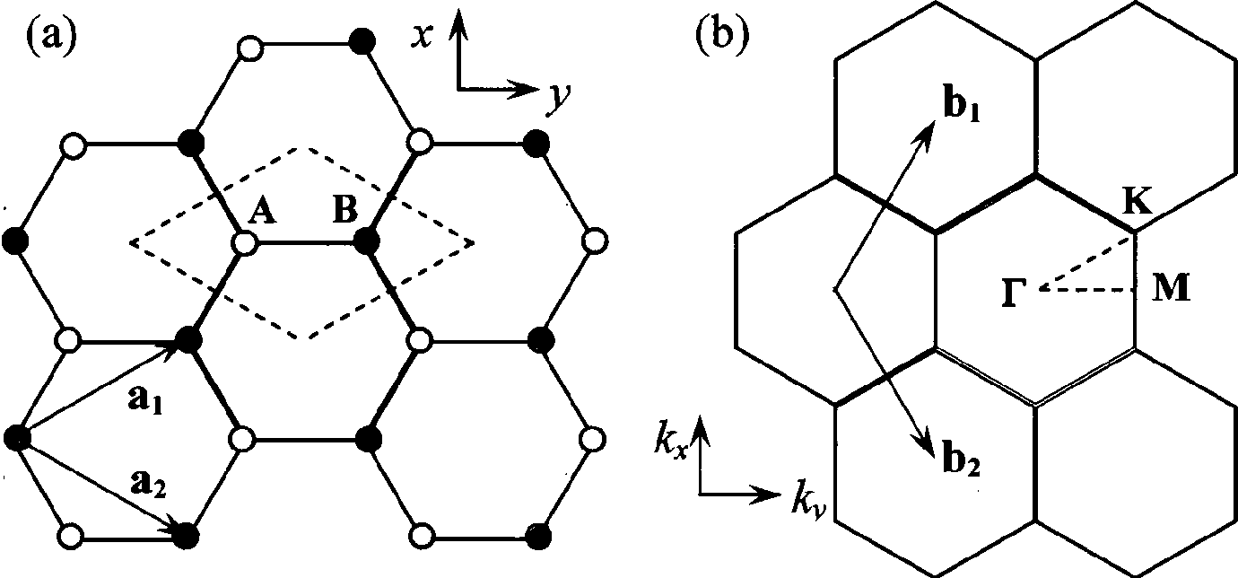
Exercise #1
Do it by yourself: Graphene’s calculation!
Basic self consistent calculation (scf)
Convergence of total energy & plane waves cutoff (ecut)
Convergence of total energy & BZ sampling (k-point)
Lattice constant (vc-relax)
Files for exercise
/graphene/
scf
ecut
Hands-on #1
k-point
vc-relax
rho
dos
bands
phonon

Slide 4
What we will do today
Hands-on #2: Charge density, Band structure, DOS, Phonon
Charge density (rho)
Density of states (dos)
Band structure (bands), Phonon dispersion (phonon)
Files for practice
/silicon/
scf
ecut
k-point
vc-relax
rho
Silicon
dos
Hands-on #2
bands
phonon

Slide 5
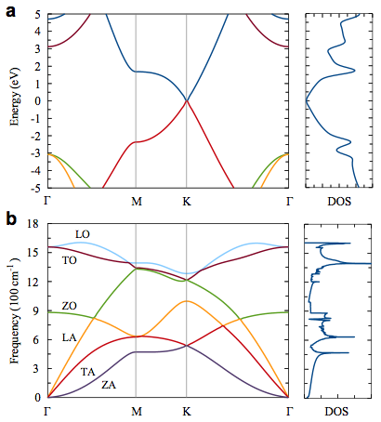
Exercise #2
Do it by yourself: Graphene’s calculation!
Charge density (rho)
Density of states (dos)
Band structure (bands)
Files for exercise
/graphene/
scf
ecut
k-point
vc-relax
rho
dos
Hands-on #2
bands
phonon

Slide 6
Structure of QE I/O file
Hands-on #1
Binary file
Text file
pw.x
Text file
input.in
output.out
Notepad++, Wordpad, vi,
emacs, …
Notepad++, Wordpad, vi,
emacs, …
pw.x < input.in > output.out
(pw.exe for Windows users)
Data file
tmp folder

Slide 7
Structure of QE I/O file
Hands-on #1
Binary file
Text file
pw.x
Text file
input.in
output.out
Notepad++, Wordpad, vi,
emacs, …
Notepad++, Wordpad, vi,
emacs, …
pw.x < input.in > output.out
(pw.exe for Windows users)
Hands-on #2
Data file
Text & data file
Binary file
tmp folder
band structure, phonon, charge density
pw.x, ph.x, pp.x, …
Text file
new input.in
gnuplot, xmgrace,
xcrysden, Vesta
pw.x < input.in > output.out
(pw.exe for Windows users)

Slide 8
Structure of QE input file
&CONTROL
calculation='scf',
restart_mode='from_scratch',
prefix='si',
pseudo_dir='../pseudo/',
outdir='../tmp/',
/
&SYSTEM
ibrav=2,
celldm(1)=10.2625,
nat=2,
ntyp=1,
ecutwfc=60.0,
ecutrho=720.0,
/
&ELECTRONS
mixing_beta=0.7,
conv_thr=1d-8,
/
ATOMIC_SPECIES
Si 28.0855 Si.pbe-rrkj.UPF
ATOMIC_POSITIONS (alat)
Si 0.00 0.00 0.00
Si 0.25 0.25 0.25
K_POINTS automatic
4 4 4 1 1 1
Silicon

Slide 9
Kohn-Sham equations
IN
RUN
OUT
Model:
unit cell
lattice vectors
basis
Physical approx:
xc-approximation
GGA, LDA, …
Numerical approx:
energy cut-off
k-points grid
SCF procedure
Physical quantities:
charge density
total energy
KS wavefunctions
KS energies
Solve Kohn-Sham equations
External nuclear
potential
Hartree
potential
Exchange-correlation
potential

Slide 10
Kohn-Sham equations
Self-consistent field (SCF) method:

Slide 11
Structure of QE input file
&CONTROL
calculation='scf',
restart_mode='from_scratch',
prefix='si',
pseudo_dir='../pseudo/',
outdir=‘../tmp/',
/
&SYSTEM
ibrav=2,
celldm(1)=10.2625,
nat=2,
ntyp=1,
ecutwfc=60.0,
ecutrho=720.0,
/
&ELECTRONS
mixing_beta=0.7,
conv_thr=1d-8,
/
ATOMIC_SPECIES
Si 28.0855 Si.pbe-rrkj.UPF
ATOMIC_POSITIONS (alat)
Si 0.00 0.00 0.00
Si 0.25 0.25 0.25
K_POINTS automatic
4 4 4 1 1 1
Construct
Initial guess
Compute
Solve
Compute
NO
YES
Energy
Forces
Self-consistent?

Slide 12
Structure of QE input file
&CONTROL
calculation='scf',
restart_mode='from_scratch',
prefix='si',
pseudo_dir='../pseudo/',
outdir=‘../tmp/',
/
&SYSTEM
ibrav=2,
celldm(1)=10.2625,
nat=2,
ntyp=1,
ecutwfc=60.0,
ecutrho=720.0,
/
&ELECTRONS
mixing_beta=0.7,
conv_thr=1d-8,
/
ATOMIC_SPECIES
Si 28.0855 Si.pbe-rrkj.UPF
ATOMIC_POSITIONS (alat)
Si 0.00 0.00 0.00
Si 0.25 0.25 0.25
K_POINTS automatic
4 4 4 1 1 1
Construct
???
Initial guess
Compute
Solve
Compute
NO
YES
Energy
Forces
Self-consistent?

Slide 13
Periodic boundary conditions
Crystal structure: Bravais lattice + Atomic basis
a1
a2
☞
Bravais lattice: (shape of unit cell & how it repeats). Specified by primitive lattice vectors a1, a2, a3
R = n1a1 + n2a2 + n3a3, where n1, n2, n3 are integers.
☞ Atomic basis: how many atoms are in the unit cell, and how they are arranged.

Slide 14
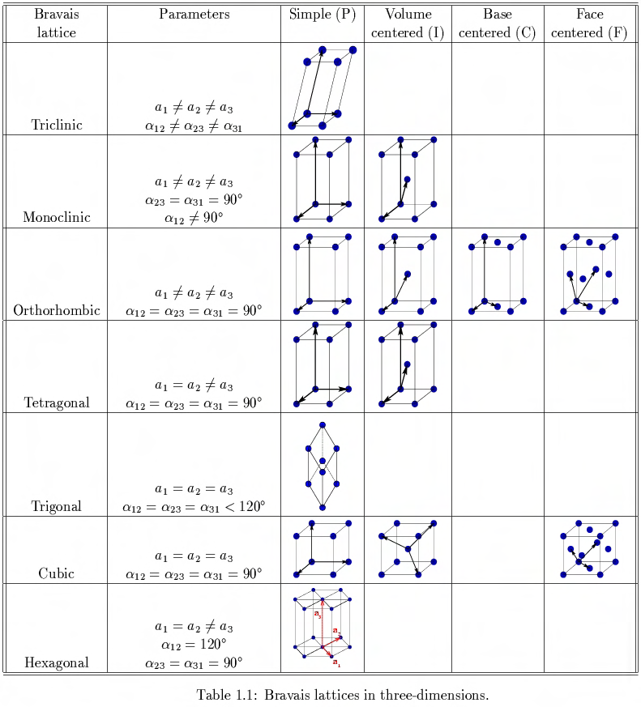
Periodic boundary conditions
4 Lattice types
7 Crystal classes

Slide 15
Structure of QE input file
&CONTROL
calculation='scf',
restart_mode='from_scratch',
prefix='si',
pseudo_dir='../pseudo/',
outdir=‘../tmp/',
/
&SYSTEM
ibrav=2,
celldm(1)=10.2625,
nat=2,
ntyp=1,
ecutwfc=60.0,
ecutrho=720.0,
/
&ELECTRONS
mixing_beta=0.7,
conv_thr=1d-8,
/
ATOMIC_SPECIES
Si 28.0855 Si.pbe-rrkj.UPF
ATOMIC_POSITIONS (alat)
Si 0.00 0.00 0.00
Si 0.25 0.25 0.25
K_POINTS automatic
4 4 4 1 1 1
ibrav = 1 (SC)
ibrav = 2 (FCC)
ibrav = 4 (Hexagonal)
…
simple cubic:
v1 = a(1,0,0)
v2 = a(0,1,0)
v3 = a(0,0,1)
face centered cubic:
v1 = (a/2)(-1,0,1)
v2 = (a/2)(0,1,1)
v3 = (a/2)(-1,1,0)

Slide 16
Structure of QE input file
&CONTROL
calculation='scf',
restart_mode='from_scratch',
prefix='si',
pseudo_dir='../pseudo/',
outdir='../tmp/',
/
&SYSTEM
ibrav=2,
celldm(1)=10.2625,
nat=2,
ntyp=1,
ecutwfc=60.0,
ecutrho=720.0,
/
&ELECTRONS
mixing_beta=0.7,
conv_thr=1d-8,
/
ATOMIC_SPECIES
Si 28.0855 Si.pbe-rrkj.UPF
ATOMIC_POSITIONS (alat)
Si 0.00 0.00 0.00
Si 0.25 0.25 0.25
K_POINTS automatic
4 4 4 1 1 1
FCC structure
v1
v2
v3
Silicon
face centered cubic:
v1 = (a/2)(-1,0,1)
v2 = (a/2)(0,1,1)
v3 = (a/2)(-1,1,0)

Slide 17
Structure of QE input file
&CONTROL
calculation='scf',
restart_mode='from_scratch',
prefix='si',
pseudo_dir='../pseudo/',
outdir='../tmp/',
/
&SYSTEM
ibrav=2,
celldm(1)=10.2625,
nat=2,
ntyp=1,
ecutwfc=60.0,
ecutrho=720.0,
/
&ELECTRONS
mixing_beta=0.7,
conv_thr=1d-8,
/
ATOMIC_SPECIES
Si 28.0855 Si.pbe-rrkj.UPF
ATOMIC_POSITIONS (alat)
Si 0.00 0.00 0.00
Si 0.25 0.25 0.25
K_POINTS automatic
4 4 4 1 1 1
FCC structure
unit bohr
a
a
a
face centered cubic:
v1 = (a/2)(-1,0,1)
v2 = (a/2)(0,1,1)
v3 = (a/2)(-1,1,0)
1 bohr = 0.529177 Å

Slide 18
Structure of QE input file
&CONTROL
calculation='scf',
restart_mode='from_scratch',
prefix='si',
pseudo_dir='../pseudo/',
outdir='../tmp/',
/
&SYSTEM
ibrav=2,
celldm(1)=10.2625,
nat=2,
ntyp=1,
ecutwfc=60.0,
ecutrho=720.0,
/
&ELECTRONS
mixing_beta=0.7,
conv_thr=1d-8,
/
ATOMIC_SPECIES
Si 28.0855 Si.pbe-rrkj.UPF
ATOMIC_POSITIONS (alat)
Si 0.00 0.00 0.00
Si 0.25 0.25 0.25
K_POINTS automatic
4 4 4 1 1 1
FCC structure
a
a
a

Slide 19
Structure of QE input file
&CONTROL
calculation='scf',
restart_mode='from_scratch',
prefix='si',
pseudo_dir='../pseudo/',
outdir='../tmp/',
/
&SYSTEM
ibrav=2,
celldm(1)=10.2625,
nat=2,
ntyp=1,
ecutwfc=60.0,
ecutrho=720.0,
/
&ELECTRONS
mixing_beta=0.7,
conv_thr=1d-8,
/
ATOMIC_SPECIES
Si 28.0855 Si.pbe-rrkj.UPF
ATOMIC_POSITIONS (alat)
Si 0.00 0.00 0.00
Si 0.25 0.25 0.25
K_POINTS automatic
4 4 4 1 1 1
FCC structure
a
a
a
Silicon

Slide 20
Structure of QE input file
&CONTROL
calculation='scf',
restart_mode='from_scratch',
prefix='si',
pseudo_dir='../pseudo/',
outdir='../tmp/',
/
&SYSTEM
ibrav=2,
celldm(1)=10.2625,
nat=2,
ntyp=1,
ecutwfc=60.0,
ecutrho=720.0,
/
&ELECTRONS
mixing_beta=0.7,
conv_thr=1d-8,
/
ATOMIC_SPECIES
Si 28.0855 Si.pbe-rrkj.UPF
ATOMIC_POSITIONS (alat)
Si 0.00 0.00 0.00
Si 0.25 0.25 0.25
K_POINTS automatic
4 4 4 1 1 1
FCC structure
a
a
a
Silicon
Mass of Si

Slide 21
Structure of QE input file
&CONTROL
calculation='scf',
restart_mode='from_scratch',
prefix='si',
pseudo_dir='../pseudo/',
outdir='../tmp/',
/
&SYSTEM
ibrav=2,
celldm(1)=10.2625,
nat=2,
ntyp=1,
ecutwfc=60.0,
ecutrho=720.0,
/
&ELECTRONS
mixing_beta=0.7,
conv_thr=1d-8,
/
ATOMIC_SPECIES
Si 28.0855 Si.pbe-rrkj.UPF
ATOMIC_POSITIONS (alat)
Si 0.00 0.00 0.00
Si 0.25 0.25 0.25
K_POINTS automatic
4 4 4 1 1 1
FCC structure
PP file
a
a
a
Silicon

Slide 22
Structure of QE input file
&CONTROL
calculation='scf',
restart_mode='from_scratch',
prefix='si',
pseudo_dir='../pseudo/',
outdir='../tmp/',
/
&SYSTEM
ibrav=2,
celldm(1)=10.2625,
nat=2,
ntyp=1,
ecutwfc=60.0,
ecutrho=720.0,
/
&ELECTRONS
mixing_beta=0.7,
conv_thr=1d-8,
/
ATOMIC_SPECIES
Si 28.0855 Si.pbe-rrkj.UPF
ATOMIC_POSITIONS (alat)
Si 0.00 0.00 0.00
Si 0.25 0.25 0.25
K_POINTS automatic
4 4 4 1 1 1
FCC structure
a
a
a
atomic positions are in cartesian coordinates, in units of the lattice parameter.

Slide 23
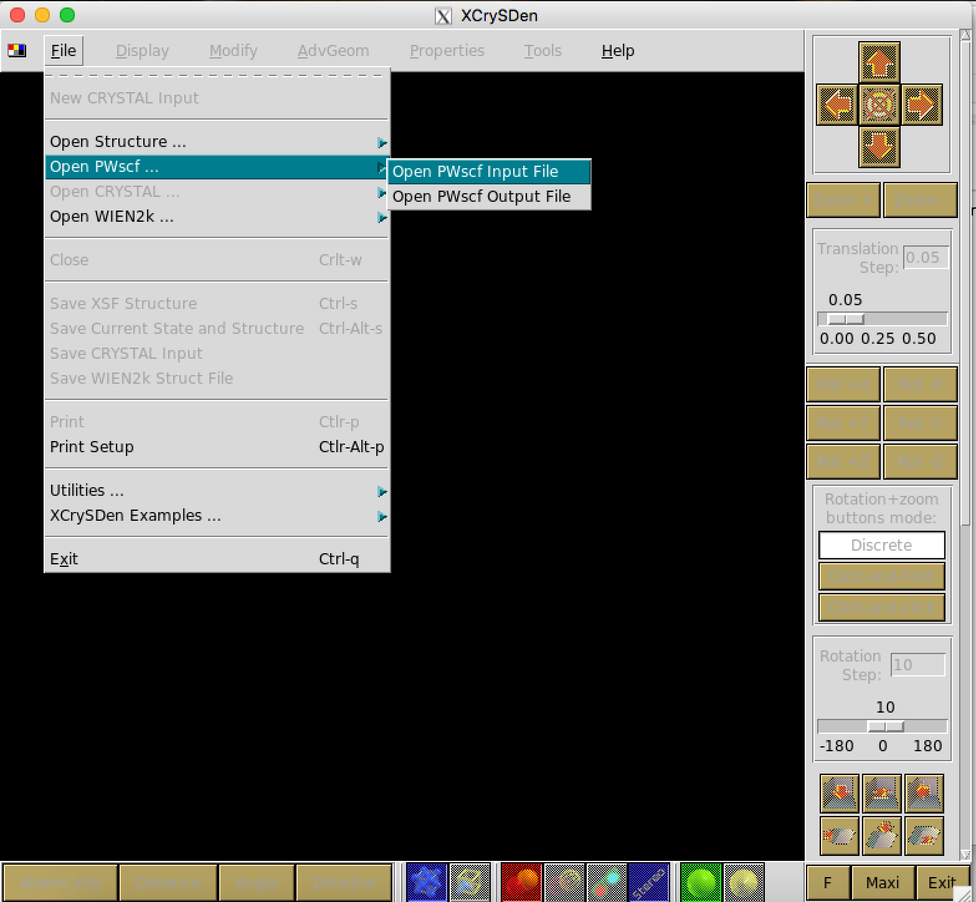
How to check model structure
Xcrysden: http://www.xcrysden.org/

Slide 24
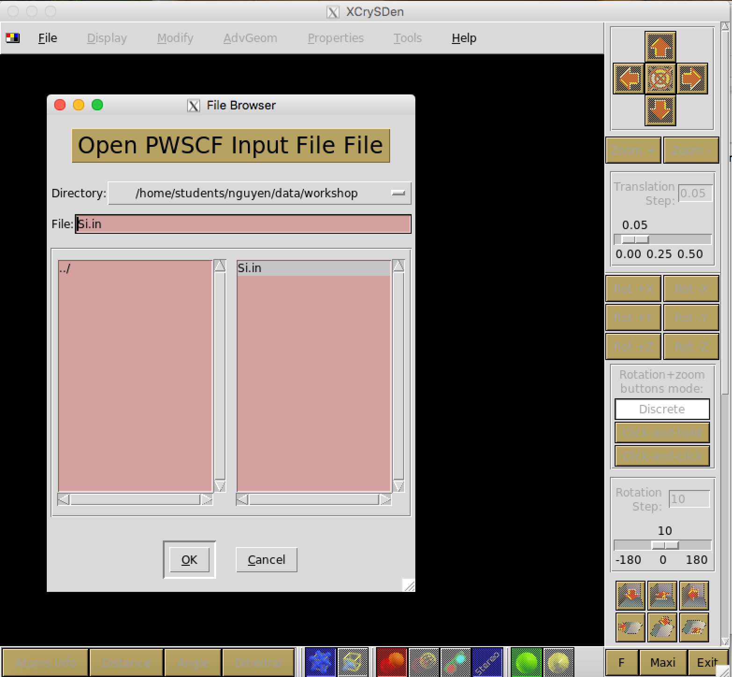
How to check model structure

Slide 25
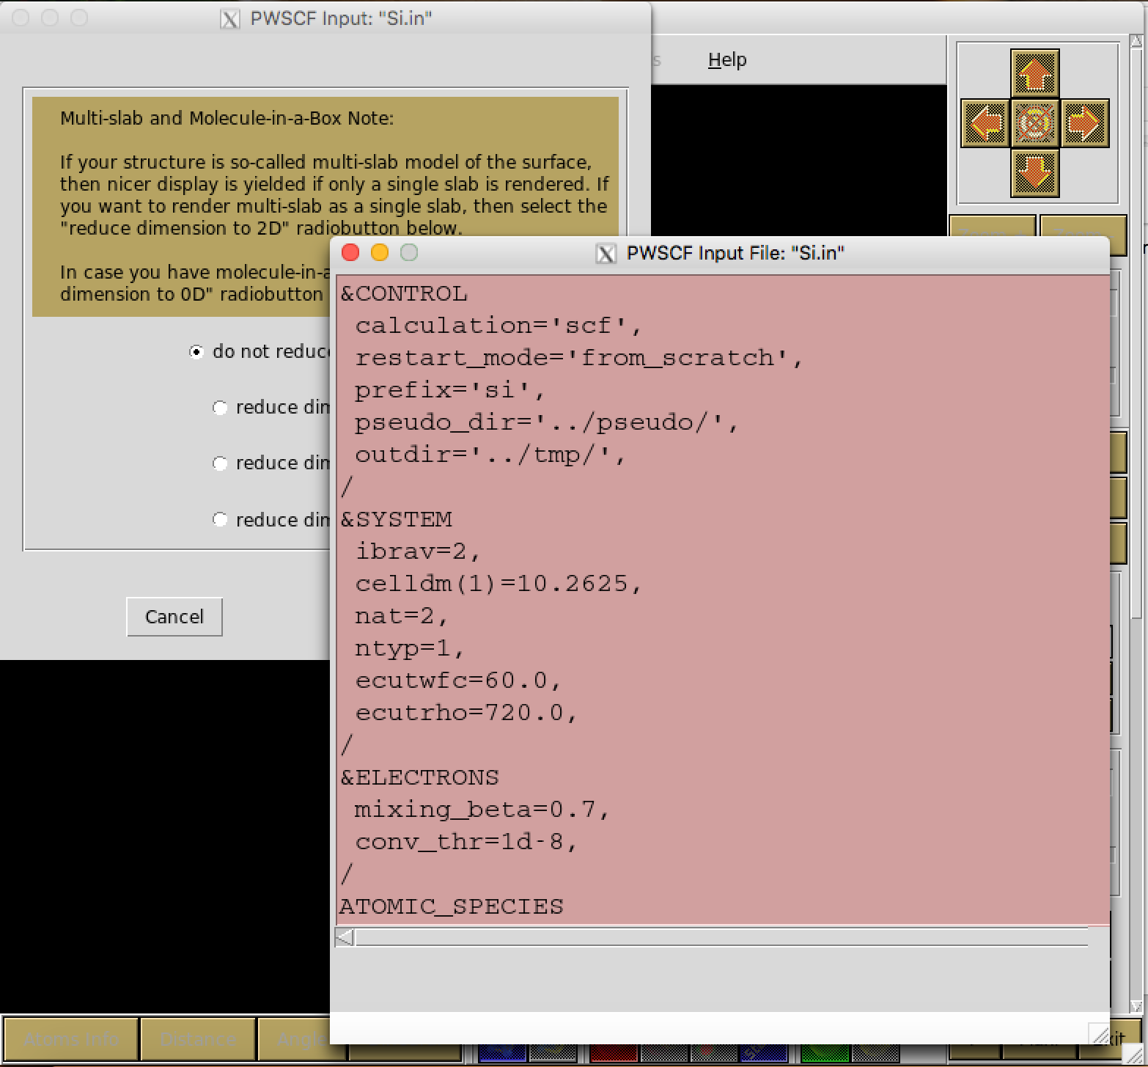
How to check model structure
Input file

Slide 26
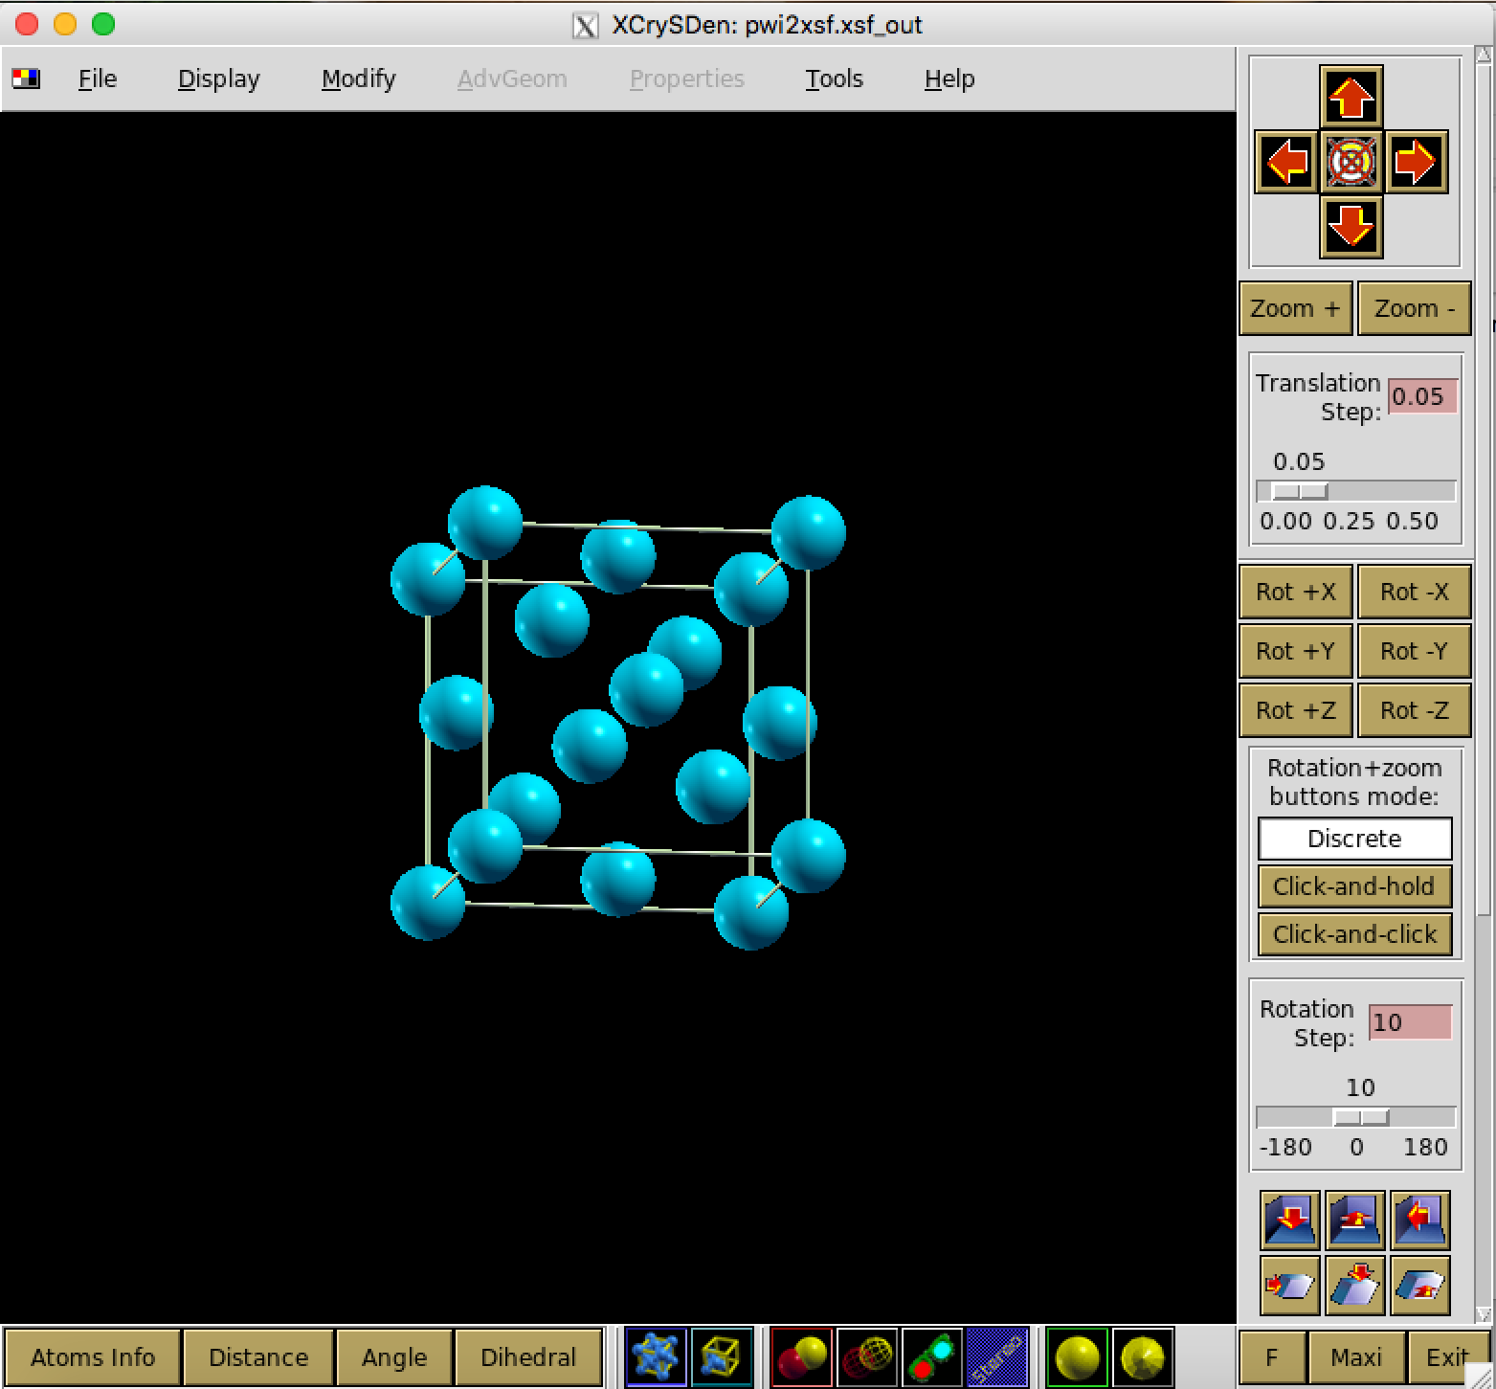
How to check model structure
Silicon structure
✔︎
Input file

Slide 27
External nuclear potential
Construct
???
Initial guess
Compute
Solve
Compute
NO
YES
Energy
Forces
Self-consistent?

Slide 28
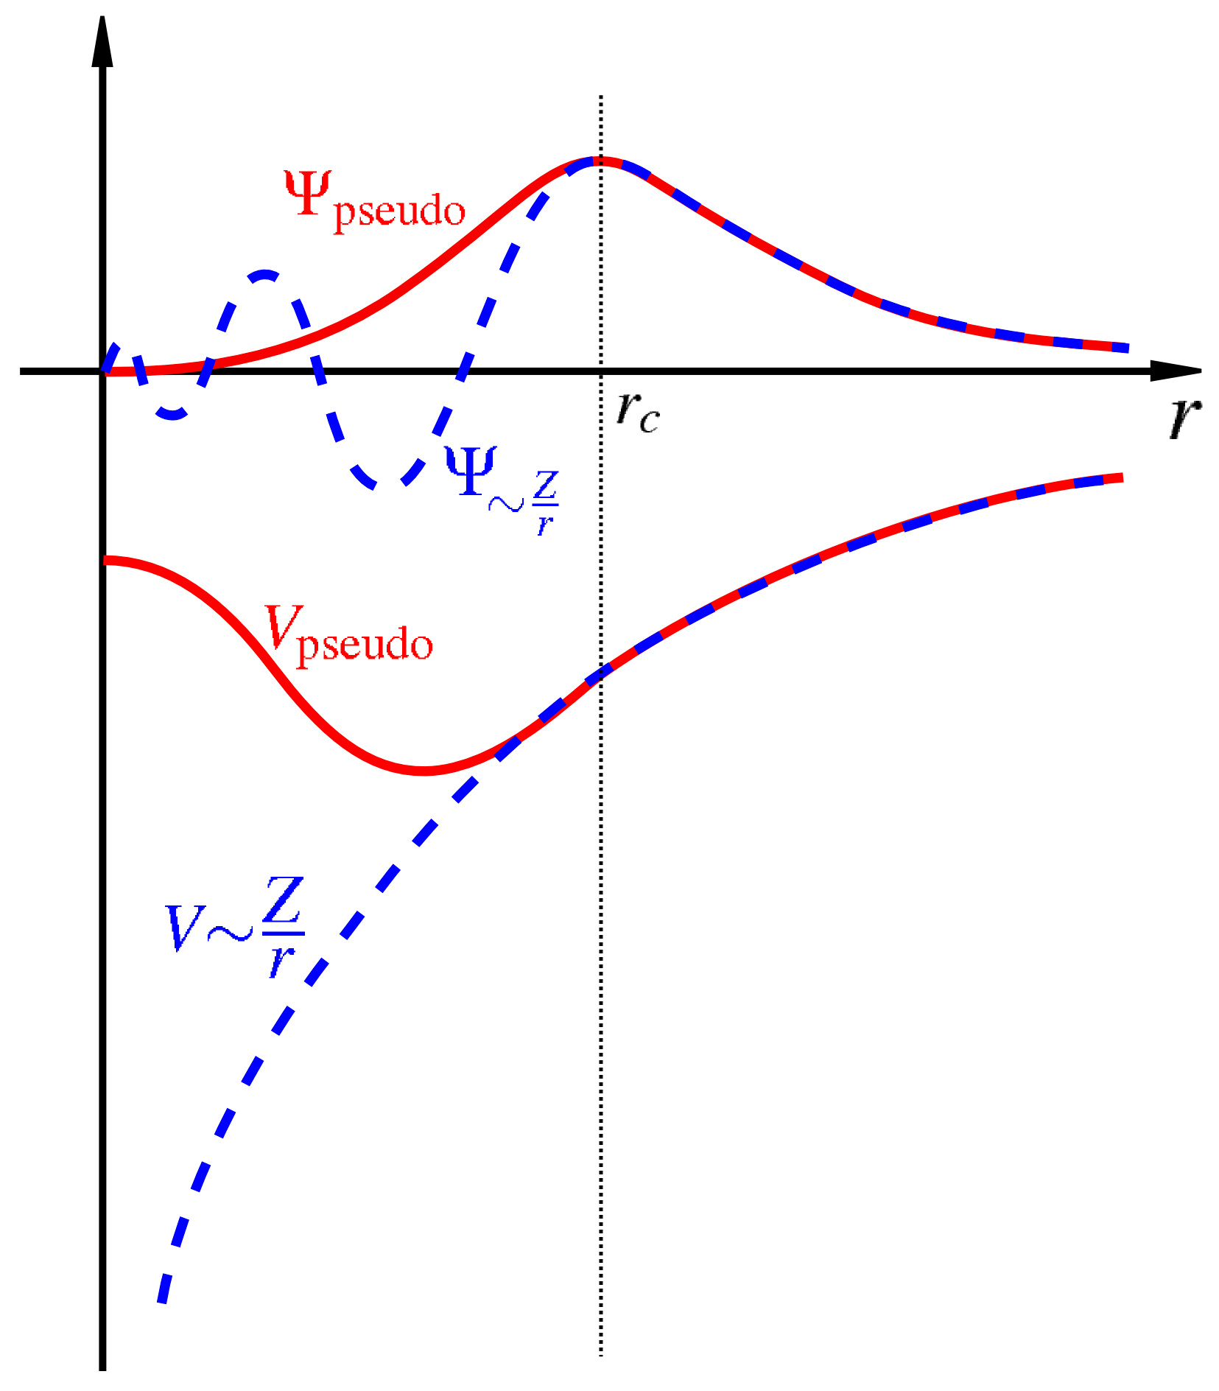
External nuclear potential
Electrons experience a Coulomb potential due to the nuclei with simple form:
valence
electrons
valence
electrons
core
electrons
pseudo-
potential
But this leads to computational problems!
Pseudopotential (PP):
Replace the strong Coulomb potential of the nucleus and tightly bound core electrons by an effective ionic potential acting on the valence electrons.
all-electron potential

Slide 29
Pseudopotential
&CONTROL
calculation='scf',
restart_mode='from_scratch',
prefix='si',
pseudo_dir='../pseudo/',
outdir='../tmp/',
/
&SYSTEM
ibrav=2,
celldm(1)=10.2625,
nat=2,
ntyp=1,
ecutwfc=60.0,
ecutrho=720.0,
/
&ELECTRONS
mixing_beta=0.7,
conv_thr=1d-8,
/
ATOMIC_SPECIES
Si 28.0855 Si.pbe-rrkj.UPF
ATOMIC_POSITIONS (alat)
Si 0.00 0.00 0.00
Si 0.25 0.25 0.25
K_POINTS automatic
4 4 4 1 1 1
Name of the pseudopotential file

Slide 30
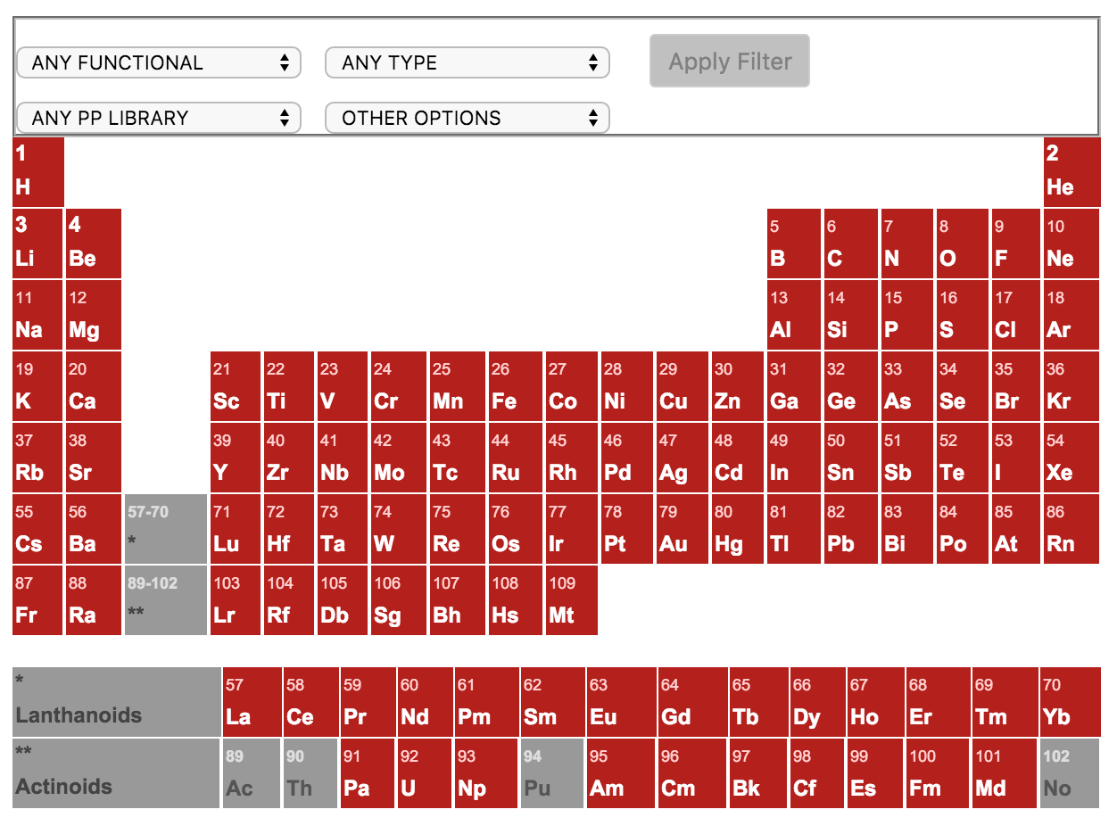
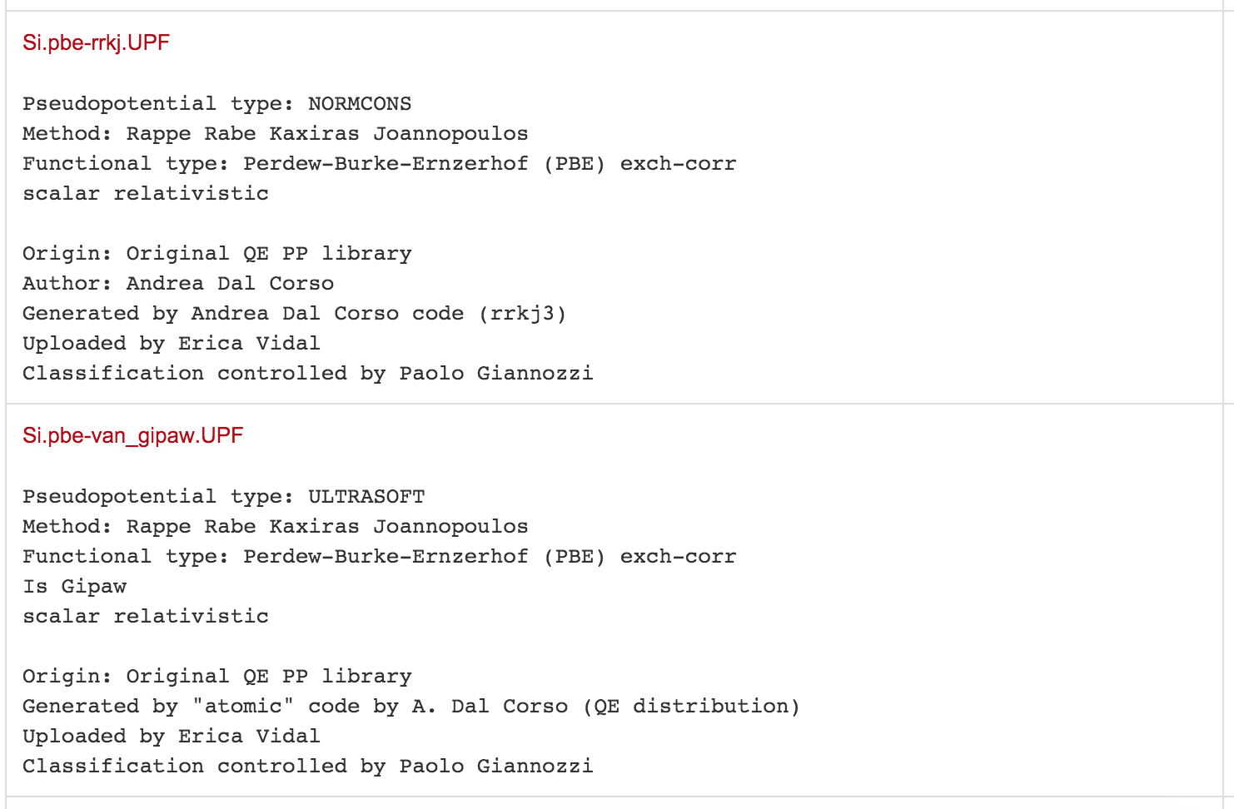
How to get pseudopotential
http://www.quantum-espresso.org/pseudopotentials/
Si.pbe-rrkj.UPF
type of exchange-correlation functional
type of pseudopotential

Slide 31
Pseudopotential
&CONTROL
calculation='scf',
restart_mode='from_scratch',
prefix='si',
pseudo_dir='../pseudo/',
outdir='../tmp/',
/
&SYSTEM
ibrav=2,
celldm(1)=10.2625,
nat=2,
ntyp=1,
ecutwfc=60.0,
ecutrho=720.0,
/
&ELECTRONS
mixing_beta=0.7,
conv_thr=1d-8,
/
ATOMIC_SPECIES
Si 28.0855 Si.pbe-rrkj.UPF
ATOMIC_POSITIONS (alat)
Si 0.00 0.00 0.00
Si 0.25 0.25 0.25
K_POINTS automatic
4 4 4 1 1 1
Si.pbe-rrkj.UPF
<PP_INFO>
Generated using Andrea Dal Corso code (rrkj3)
Author: Andrea Dal Corso Generation date: unknown
Info: Si PBE 3s2 3p2 RRKJ3
0 The Pseudo was generated with a Non-Relativistic Calculation
2.50000000000E+00 Local Potential cutoff radius
nl pn l occ Rcut Rcut US E pseu
3S 1 0 2.00 2.50000000000 2.60000000000 0.00000000000
3S 1 0 0.00 2.50000000000 2.60000000000 0.00000000000
3P 2 1 2.00 2.50000000000 2.70000000000 0.00000000000
3D 3 2 0.00 2.50000000000 2.50000000000 0.00000000000
</PP_INFO>
<PP_HEADER>
0 Version Number
Si Element
NC Norm - Conserving pseudopotential
F Nonlinear Core Correction
SLA PW PBE PBE PBE Exchange-Correlation functional
4.00000000000 Z valence
-7.47480832270 Total energy
0.0000000 0.0000000 Suggested cutoff for wfc and rho
2 Max angular momentum component
883 Number of points in mesh
2 3 Number of Wavefunctions, Number of Projectors
Wavefunctions nl l occ
3S 0 2.00
3P 1 2.00
</PP_HEADER>
<PP_MESH>
<PP_R>
1.77053726905E-04 1.79729551320E-04 1.82445815642E-04 1.85203131043E-04
1.88002117930E-04 1.90843406086E-04 1.93727634813E-04 1.96655453076E-04
1.99627519645E-04 2.02644503249E-04 2.05707082721E-04 2.08815947154E-04
2.11971796056E-04 2.15175339506E-04 2.18427298316E-04 2.21728404189E-04
2.25079399889E-04 2.28481039403E-04 2.31934088115E-04 2.35439322975E-04
2.38997532677E-04 2.42609517831E-04 2.46276091150E-04 2.49998077629E-04
2.53776314730E-04 2.57611652573E-04 2.61504954124E-04 2.65457095393E-04
2.69468965628E-04 2.73541467517E-04 2.77675517391E-04 2.81872045428E-04
2.86131995864E-04 2.90456327206E-04 2.94846012447E-04 2.99302039285E-04
3.03825410344E-04 3.08417143402E-04 3.13078271619E-04 3.17809843768E-04
3.22612924472E-04 3.27488594446E-04 3.32437950735E-04 3.37462106965E-04
3.42562193593E-04 3.47739358159E-04 3.52994765549E-04 3.58329598249E-04

Slide 32
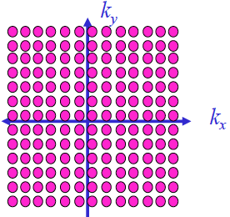
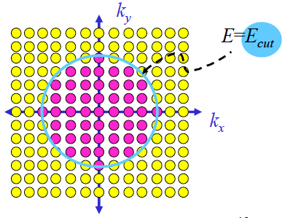
Plane wave expansion
In a periodic system we can write the KS states as a superposition of plane waves:
G are vectors in reciprocal space.
The sum, in principle infinite, can be truncated:

Slide 33
Plane wave expansion
&CONTROL
calculation='scf',
restart_mode='from_scratch',
prefix='si',
pseudo_dir='../pseudo/',
outdir='../tmp/',
/
&SYSTEM
ibrav=2,
celldm(1)=10.2625,
nat=2,
ntyp=1,
ecutwfc=60.0,
ecutrho=720.0,
/
&ELECTRONS
mixing_beta=0.7,
conv_thr=1d-8,
/
ATOMIC_SPECIES
Si 28.0855 Si.pbe-rrkj.UPF
ATOMIC_POSITIONS (alat)
Si 0.00 0.00 0.00
Si 0.25 0.25 0.25
K_POINTS automatic
4 4 4 1 1 1
Units: Ry (1 Ry = 0.5 Ha = 13.6057 eV)
For ultrasoft pseudopotentials we have also:
ecutrho = usually 8-12 ⨉ ecutwfc

Slide 34
Initial n(r)
Construct
✔︎
Initial guess
Compute
Solve
Compute
NO
YES
Energy
Forces
Self-consistent?

Slide 35
Initial n(r)
&CONTROL
calculation='scf',
restart_mode='from_scratch',
prefix='si',
pseudo_dir='../pseudo/',
outdir='../tmp/',
/
&SYSTEM
ibrav=2,
celldm(1)=10.2625,
nat=2,
ntyp=1,
ecutwfc=60.0,
ecutrho=720.0,
/
&ELECTRONS
mixing_beta=0.7,
conv_thr=1d-8,
/
ATOMIC_SPECIES
Si 28.0855 Si.pbe-rrkj.UPF
ATOMIC_POSITIONS (alat)
Si 0.00 0.00 0.00
Si 0.25 0.25 0.25
K_POINTS automatic
4 4 4 1 1 1
startingwfc = ‘atomic’(DEFAULT)
= ‘random’
= ‘file’

Slide 36
Sampling of the Brillouin zone
Many quantities we need to compute involve an integral over the BZ:
An example is the electronic density n(r):
In practice the integral is discretized:
How do we choose the k points to include in the sum???

Slide 37
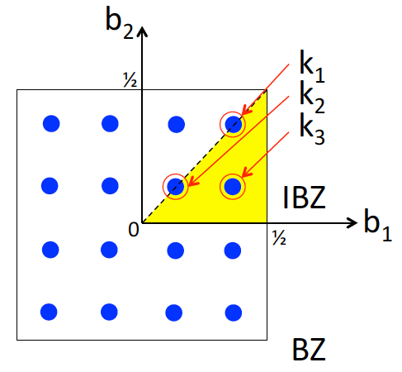
Monkhorst and Pack (1976)
Example: square 2D lattice
4⨉4 k-points grid (16 points)
3 inequivalent point (IBZ)

Slide 38
Sampling of the Brillouin zone
&CONTROL
calculation='scf',
restart_mode='from_scratch',
prefix='si',
pseudo_dir='../pseudo/',
outdir='../tmp/',
/
&SYSTEM
ibrav=2,
celldm(1)=10.2625,
nat=2,
ntyp=1,
ecutwfc=60.0,
ecutrho=720.0,
/
&ELECTRONS
mixing_beta=0.7,
conv_thr=1d-8,
/
ATOMIC_SPECIES
Si 28.0855 Si.pbe-rrkj.UPF
ATOMIC_POSITIONS (alat)
Si 0.00 0.00 0.00
Si 0.25 0.25 0.25
K_POINTS automatic
4 4 4 1 1 1
K_POINTS automatic
nk1, nk2, nk3, k1, k2, k3
nk1, nk2, nk3 as in Monkhorst-Pack grids k1, k2, k3 must be 0 ( no offset ) or 1 ( grid displaced by half a grid step in the corresponding direction )

Slide 39
QE run
Construct
✔︎
Initial guess
✔︎
Compute
Solve
Compute
NO
YES
Energy
Forces
Self-consistent?

Slide 40
QE run
Construct
✔︎
Initial guess
✔︎
Compute
Si.pbe-rrkj.UPF
GGA
Solve
Compute
NO
YES
Energy
Forces
Self-consistent?

Slide 41
QE run
Construct
✔︎
Initial guess
✔︎
Compute
✔︎
✔︎
Solve
Expensive
Compute
NO
YES
Energy
Forces
Self-consistent?

Slide 42
Solve wave equation
&CONTROL
calculation='scf',
restart_mode='from_scratch',
prefix='si',
pseudo_dir='../pseudo/',
outdir='../tmp/',
/
&SYSTEM
ibrav=2,
celldm(1)=10.2625,
nat=2,
ntyp=1,
ecutwfc=60.0,
ecutrho=720.0,
/
&ELECTRONS
mixing_beta=0.7,
conv_thr=1d-8,
/
ATOMIC_SPECIES
Si 28.0855 Si.pbe-rrkj.UPF
ATOMIC_POSITIONS (alat)
Si 0.00 0.00 0.00
Si 0.25 0.25 0.25
K_POINTS automatic
4 4 4 1 1 1
diagonalization = ‘david’ (DEFAULT)
= ‘cg’

Slide 43
QE run
Construct
✔︎
Initial guess
✔︎
Compute
✔︎
✔︎
Solve
✔︎
Compute
NO
YES
Energy
Forces
Self-consistent?

Slide 44
QE run
Construct
✔︎
Initial guess
✔︎
Compute
✔︎
✔︎
Solve
✔︎
Compute
✔︎
NO
YES
Energy
Forces
Self-consistent?

Slide 45
Self-consistency
&CONTROL
calculation='scf',
restart_mode='from_scratch',
prefix='si',
pseudo_dir='../pseudo/',
outdir='../tmp/',
/
&SYSTEM
ibrav=2,
celldm(1)=10.2625,
nat=2,
ntyp=1,
ecutwfc=60.0,
ecutrho=720.0,
/
&ELECTRONS
mixing_beta=0.7,
conv_thr=1d-8,
/
ATOMIC_SPECIES
Si 28.0855 Si.pbe-rrkj.UPF
ATOMIC_POSITIONS (alat)
Si 0.00 0.00 0.00
Si 0.25 0.25 0.25
K_POINTS automatic
4 4 4 1 1 1
Convergence threshold for self-consistency:
estimated energy error > conv_thr (NO)
or energy error < conv_thr (YES)

Slide 46
QE run
Construct
✔︎
Initial guess
✔︎
Compute
✔︎
✔︎
Solve
✔︎
Compute
✔︎
NO
YES
Energy
Forces
Self-consistent?

Slide 47
new n(r)
&CONTROL
calculation='scf',
restart_mode='from_scratch',
prefix='si',
pseudo_dir='../pseudo/',
outdir='../tmp/',
/
&SYSTEM
ibrav=2,
celldm(1)=10.2625,
nat=2,
ntyp=1,
ecutwfc=60.0,
ecutrho=720.0,
/
&ELECTRONS
mixing_beta=0.7,
conv_thr=1d-8,
/
ATOMIC_SPECIES
Si 28.0855 Si.pbe-rrkj.UPF
ATOMIC_POSITIONS (alat)
Si 0.00 0.00 0.00
Si 0.25 0.25 0.25
K_POINTS automatic
4 4 4 1 1 1
Mix new and old density:
0.7 = 70% of the new density and 30% of old density at first step

Slide 48
QE run
Construct
✔︎
Initial guess
✔︎
Compute
✔︎
✔︎
Solve
✔︎
Compute
✔︎
✔︎
NO
YES
Energy
Forces
Self-consistent?

Slide 49
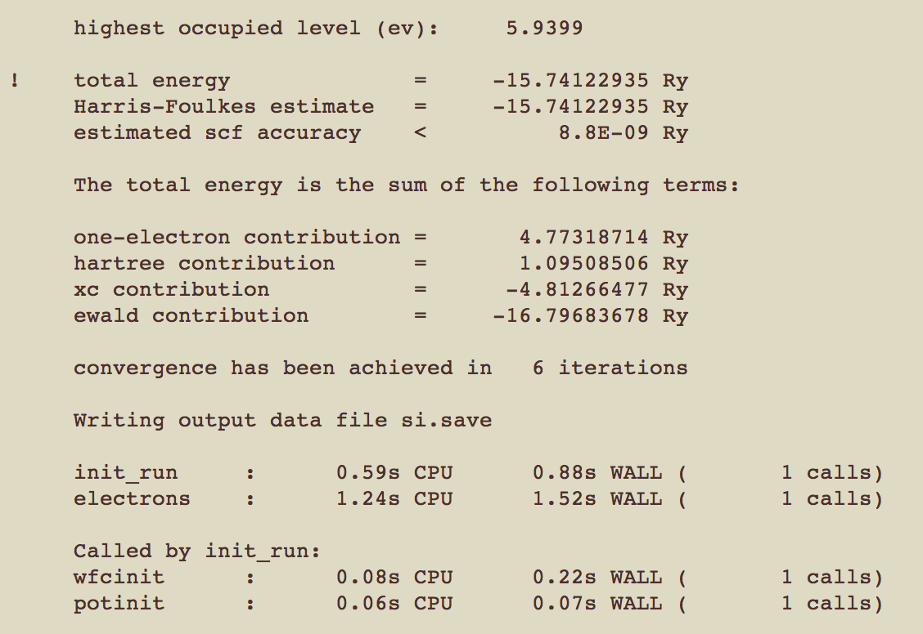
Total energy
$ pw.x <Si.scf.in> Si.scf.out &
$ vi Si.scf.out
or
$ grep ! Si.scf.out

Slide 50
QE run
Construct
Fixed ions
Initial guess
Compute
Move ions
Solve
Compute
NO
YES
Energy
Forces
Self-consistent?

Slide 51
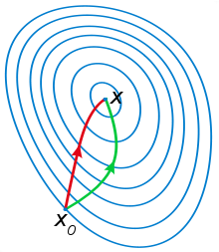
Structure optimization
&CONTROL
calculation=‘vc-relax',
restart_mode='from_scratch',
prefix='si',
pseudo_dir='../pseudo/',
outdir=‘../tmp/',
forc_conv_thr=1d-5,
/
&SYSTEM
ibrav=2,
celldm(1)=10.2625,
nat=2,
ntyp=1,
ecutwfc=60.0,
ecutrho=720.0,
/
&ELECTRONS
mixing_beta=0.7,
conv_thr=1d-8,
/
&IONS
ion_dynamics='bfgs',
/
&CELL
cell_dynamics='bfgs',
press=0.0,
press_conv_thr=0.5,
/
ATOMIC_SPECIES
Si 28.0855 Si.pbe-rrkj.UPF
ATOMIC_POSITIONS (alat)
Si 0.00 0.00 0.00
Si 0.25 0.25 0.25
K_POINTS automatic
4 4 4 1 1 1
Broyden–Fletcher–Goldfarb–Shanno (BFGS) algorithm is an iterative method for solving unconstrained nonlinear optimization problems.

Slide 52
Structure optimization
&CONTROL
calculation=‘vc-relax',
restart_mode='from_scratch',
prefix='si',
pseudo_dir='../pseudo/',
outdir=‘../tmp/',
forc_conv_thr=1d-5,
/
&SYSTEM
ibrav=2,
celldm(1)=10.2625,
nat=2,
ntyp=1,
ecutwfc=60.0,
ecutrho=720.0,
/
&ELECTRONS
mixing_beta=0.7,
conv_thr=1d-8,
/
&IONS
ion_dynamics='bfgs',
/
&CELL
cell_dynamics='bfgs',
press=0.0,
press_conv_thr=0.5,
/
ATOMIC_SPECIES
Si 28.0855 Si.pbe-rrkj.UPF
ATOMIC_POSITIONS (alat)
Si 0.00 0.00 0.00
Si 0.25 0.25 0.25
K_POINTS automatic
4 4 4 1 1 1
Cell lattice parameters and free (internal) coordinates of the atoms may be changed by relaxation

Slide 53
What we will do today
Hands-on #1: Total energy and relaxations for Silicon
Basic self consistent calculation (scf)
Convergence of total energy & plane waves cutoff (ecut)
Convergence of total energy & BZ sampling (k-point)
Lattice constant (vc-relax)
Files for practice
/silicon/
scf
ecut
Hands-on #1
k-point
vc-relax
rho
Silicon
dos
bands
phonon

Slide 54
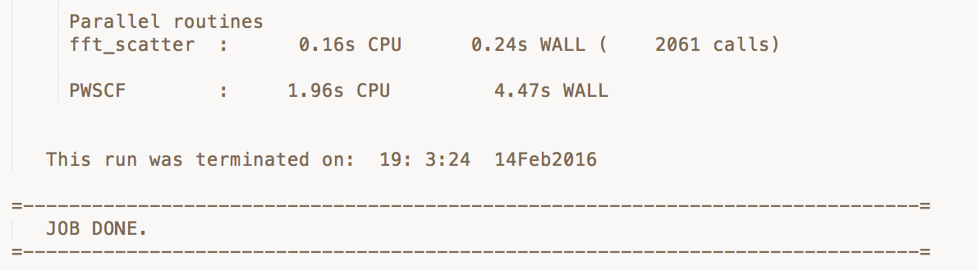
Result
Hands-on #1
Basic self consistent calculation (scf)
/silicon/
scf
Command: $ pw.x <Si.scf.in> Si.scf.out
(pw.exe for Windows users)

Slide 55
Result
Hands-on #1
Convergence of total energy & plane waves cutoff (ecut)
/silicon/
ecut
Command: $ pw.x <Si.ecut.#.in> Si.ecut.#.out
(pw.exe for Windows users)
Total energy (Ry)
Time (s)
Ecut (Ry)
Ecut (Ry)

Slide 56
Result
Hands-on #1
Convergence of total energy & BZ sampling (k-point)
/silicon/
ecut
Command: $ pw.x <Si.k-point.#.#.in> Si.k-point.#.#.out
(pw.exe for Windows users)
offset
no offset
Total energy (Ry)
Time (s)
no offset
offset
k points
k points

Slide 57
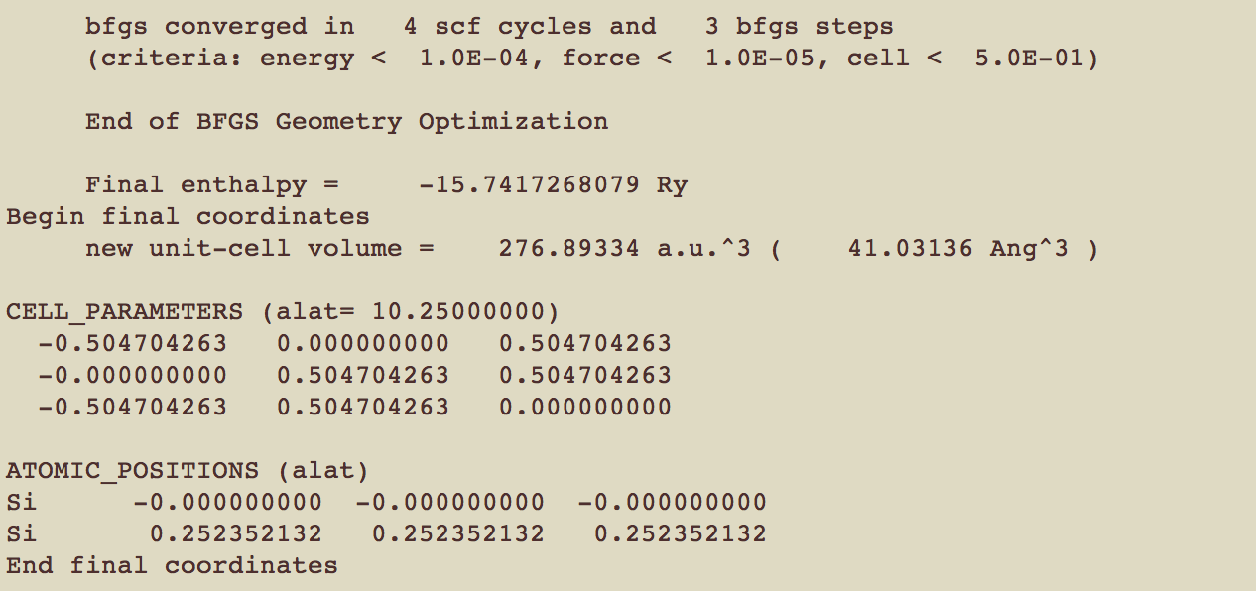
Result
Hands-on #1
a
Lattice constant (vc-relax)
a
a
/silicon/
ecut
Input:
a = 10.2500 Bohr
Command: $ pw.x <Si.vc-relax.in> Si.vc-relax.out
(pw.exe for Windows users)
Output:
a = 10.3464 Bohr

Slide 58
Exercise #1
Do it by yourself: Graphene’s calculation!
Basic self consistent calculation (scf)
Convergence of total energy & plane waves cutoff (ecut)
Convergence of total energy & BZ sampling (k-point)
Lattice constant (vc-relax)
Files for exercise
/graphene/
scf
ecut
Hands-on #1
k-point
vc-relax
rho
dos
bands
phonon

Slide 59
Structure of QE I/O file
Hands-on #1
Binary file
Text file
pw.x
Text file
input.in
output.out
Notepad++, Wordpad, vi,
emacs, …
Notepad++, Wordpad, vi,
emacs, …
pw.x < input.in > output.out
(pw.exe for Windows users)
Hands-on #2
Data file
Text & data file
Binary file
tmp folder
band structure, phonon, charge density
pw.x, ph.x, pp.x, …
Text file
new input.in
gnuplot, xmgrace,
xcrysden, Vesta
pw.x < input.in > output.out
(pw.exe for Windows users)

Slide 60
Charge density
Command:
$ pw.x < Si.scf.in > Si.scf.out
$ pp.x < Si.pp.in > Si.pp.out
Step 1: SCF calculation (Hands-on #1)
Step 2: Visual charge density
(*.exe for Windows users)
Files for charge density
/silicon/
scf
ecut
k-point
vc-relax
rho
dos
bands
phonon

Slide 61
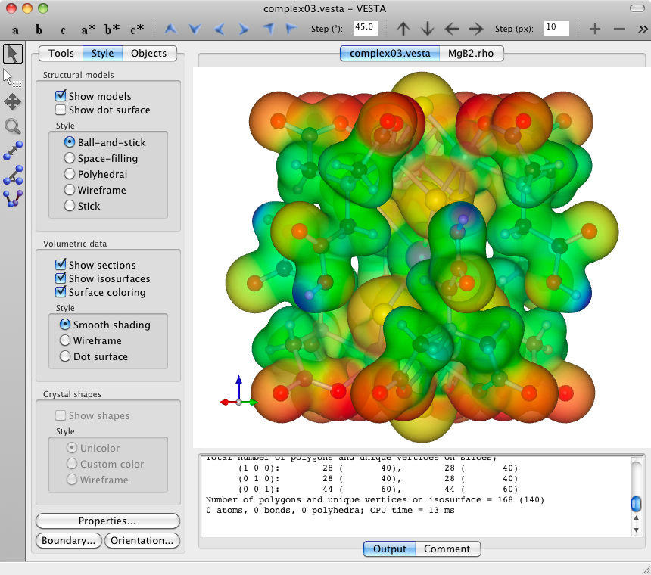
Charge density
Command:
$ pw.x < Si.scf.in > Si.scf.out
$ pp.x < Si.pp.in > Si.pp.out
Step 1: SCF calculation (Hands-on #1)
Step 2: Visual charge density
(*.exe for Windows users)
Si.pp.in
&INPUTPP
outdir='../tmp/',
prefix='si',
plot_num=0,
/
&PLOT
iflag=3,
output_format=6,
fileout='si_rho.cube',
nx=64,ny=64,nz=64,
/
Data of wavefunctions in step SCF
VESTA: http://jp-minerals.org/vesta/en/
Data of charge density

Slide 62
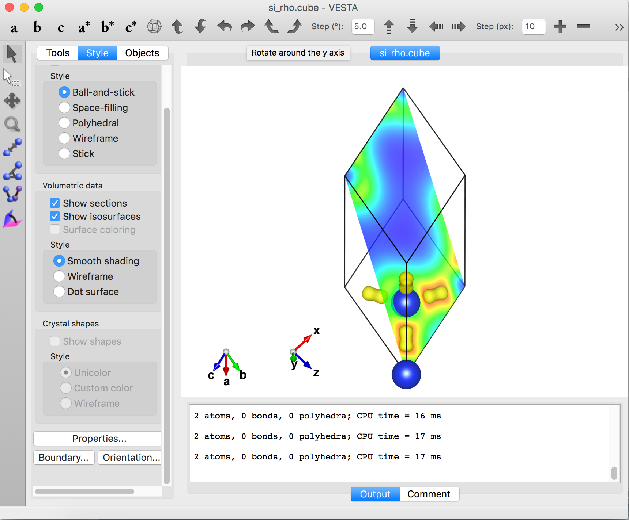
Charge density
Charge density
Silicon atoms

Slide 63
Density of states (DOS)
Command:
$ pw.x < Si.scf.in > Si.scf.out
$ pw.x < Si.nscf.in > Si.nscf.out
$ dos.x < Si.dos.in > Si.dos.out
Step 1: SCF calculation (Hands-on #1)
Step 2: Non-SCF calculation
Step 3: Plot DOS
(*.exe for Windows users)
Files for density of states
/silicon/
scf
ecut
k-point
vc-relax
rho
dos
bands
phonon

Slide 64
Density of states (DOS)
Command:
$ pw.x < Si.scf.in > Si.scf.out
$ pw.x < Si.nscf.in > Si.nscf.out
$ dos.x < Si.dos.in > Si.dos.out
Step 1: SCF calculation (Hands-on #1)
Step 2: Non-SCF calculation
Step 3: Plot DOS
(*.exe for Windows users)
Si.nscf.in
&CONTROL
calculation='nscf',
restart_mode='from_scratch',
prefix='si',
pseudo_dir='../pseudo/',
outdir='../tmp/',
/
&SYSTEM
ibrav=2,
celldm(1)=10.2625,
nat=2,
ntyp=1,
ecutwfc=60.0,
ecutrho=720.0,
nbnd=8,
occupations='tetrahedra',
/
&ELECTRONS
mixing_beta=0.7,
conv_thr=1d-8,
/
ATOMIC_SPECIES
Si 28.0855 Si.pbe-rrkj.UPF
ATOMIC_POSITIONS (alat)
Si 0.00 0.00 0.00
Si 0.25 0.25 0.25
K_POINTS automatic
12 12 12 1 1 1
non-SCF calculation
Linear tetrahedron method
High density k-point

Slide 65
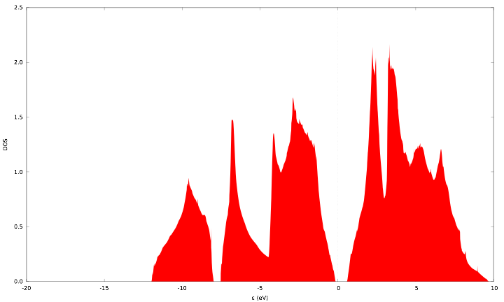
Density of states (DOS)
Command:
$ pw.x < Si.scf.in > Si.scf.out
$ pw.x < Si.nscf.in > Si.nscf.out
$ dos.x < Si.dos.in > Si.dos.out
Step 1: SCF calculation (Hands-on #1)
Step 2: Non-SCF calculation
Step 3: Plot DOS
(*.exe for Windows users)
Si.dos.in
&DOS
prefix='si',
outdir='../tmp/',
fildos='si.dos'
emin=-9.0,
emax=16.0,
/
Data file of DOS (state/eV)
Command:
$ gnuplot < si_dos.gnu

Slide 66
Band structure
Command:
$ pw.x < Si.scf.in > Si.scf.out
$ pw.x < Si.nscf.in > Si.nscf.out
$ bands.x <Si.bands.in > Si.bands.out
$ plotband.x <Si.plotband
Step 1: SCF calculation (Hands-on #1)
Step 2: Non-SCF calculation
Step 3: Data of bands structure
Step 4: Plot band structure
(*.exe for Windows users)
Files for band structure
/silicon/
scf
ecut
k-point
vc-relax
rho
dos
bands
phonon

Slide 67
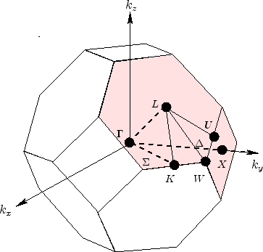
Band structure
Command:
$ pw.x < Si.scf.in > Si.scf.out
$ pw.x < Si.nscf.in > Si.nscf.out
$ bands.x <Si.bands.in > Si.bands.out
$ plotband.x <Si.plotband
Step 1: SCF calculation (Hands-on #1)
Step 2: Non-SCF calculation
Step 3: Data of bands structure
Step 4: Plot band structure
Si.nscf.in
(*.exe for Windows users)
&CONTROL
calculation='bands',
restart_mode='from_scratch',
prefix='si',
pseudo_dir='../pseudo/',
outdir='../tmp/',
/
&SYSTEM
ibrav=2,
celldm(1)=10.2625,
nat=2,
ntyp=1,
ecutwfc=60.0,
ecutrho=720.0,
nbnd=8,
/
&ELECTRONS
mixing_beta=0.7,
conv_thr=1d-8,
/
ATOMIC_SPECIES
Si 28.0855 Si.pbe-rrkj.UPF
ATOMIC_POSITIONS (alat)
Si 0.00 0.00 0.00
Si 0.25 0.25 0.25
K_POINTS automatic
K_POINTS {crystal_b}
5
0.0000000000 0.0000000000 -0.5000000000 20
0.0000000000 0.0000000000 0.0000000000 30
-0.5000000000 0.0000000000 -0.5000000000 10
-0.3750000000 0.0000000000 -0.6250000000 30
0.0000000000 0.0000000000 0.0000000000 20
non-SCF calculation
Selected special k-point coordinates
L
Γ
X
U
Γ

Slide 68
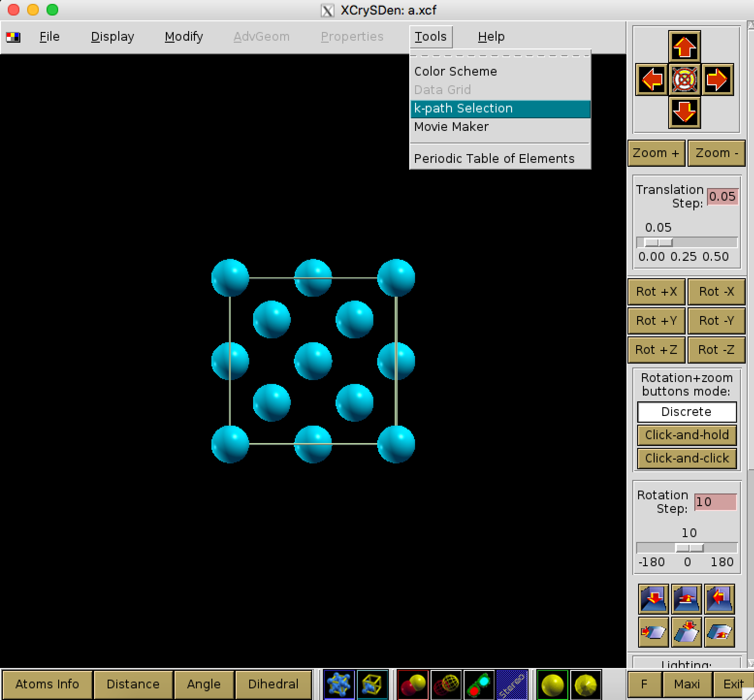
XCrySDen k-Path
Xcrysden: http://www.xcrysden.org/

Slide 69
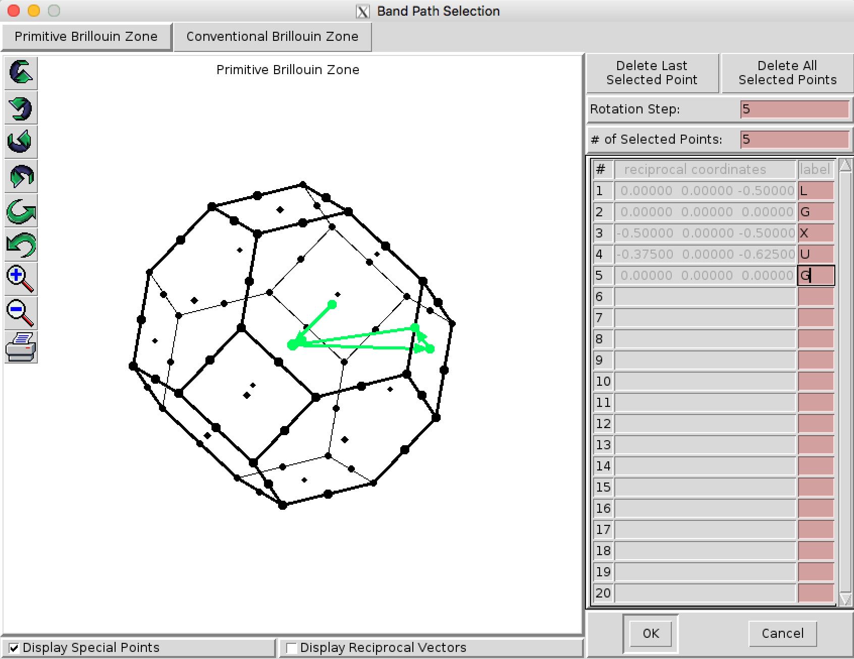
XCrySDen k-Path

Slide 70
Band structure
Command:
$ pw.x < Si.scf.in > Si.scf.out
$ pw.x < Si.nscf.in > Si.nscf.out
$ bands.x <Si.bands.in > Si.bands.out
$ plotband.x <Si.plotband
Step 1: SCF calculation (Hands-on #1)
Step 2: Non-SCF calculation
Step 3: Data of bands structure
Step 4: Plot band structure
(*.exe for Windows users)
Si.bands.in
&BANDS
outdir='../tmp/',
prefix='si',
filband='si.bands',
/
Name of data file

Slide 71
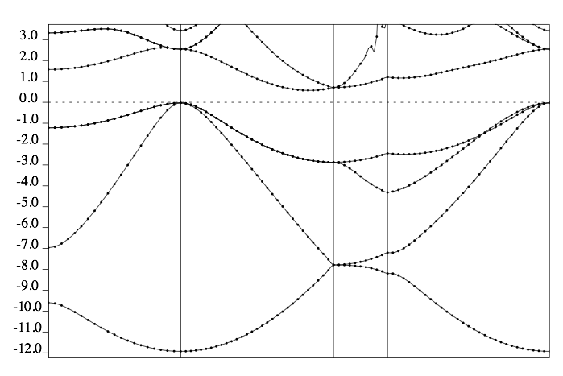
Band structure
Command:
$ pw.x < Si.scf.in > Si.scf.out
$ pw.x < Si.nscf.in > Si.nscf.out
$ bands.x <Si.bands.in > Si.bands.out
$ plotband.x <Si.plotband
Step 1: SCF calculation (Hands-on #1)
Step 2: Non-SCF calculation
Step 3: Data of bands structure
Step 4: Plot band structure
(*.exe for Windows users)
Si.plotband
si.bands
-6.0 10
si.bands.xmgr
si.bands.ps
6.255
1.0 6.255
Data file
Energy (eV)
L
Γ
X
U
Γ

Slide 72
Phonon
Command:
$ pw.x < Si.scf.in > Si.scf.out
$ ph.x < Si.ph.in > Si.ph.out
$ q2r.x <Si.q2r.in > Si.q2r.out
$ matdyn.x <Si.matdyn.in > Si.matdyn.out
Step 1: SCF calculation (Hands-on #1)
Step 2: Calculation of dynamical matrices on q-vectors
Step 3: Calculation of IFC's in real space
Step 4: A plot of the phonon DOS
(*.exe for Windows users)
Files for phonon
/silicon/
scf
ecut
k-point
vc-relax
rho
dos
bands
phonon

Slide 73
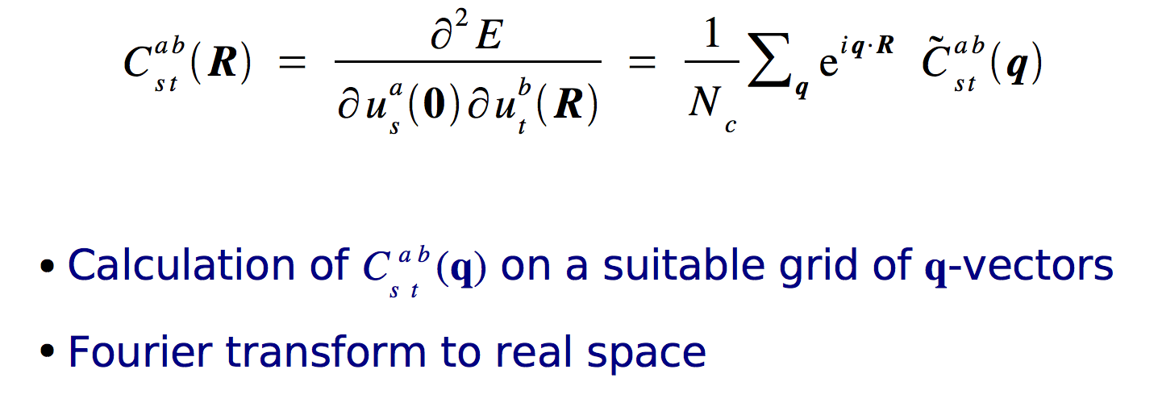
Phonon
Command:
$ pw.x < Si.scf.in > Si.scf.out
$ ph.x < Si.ph.in > Si.ph.out
$ q2r.x <Si.q2r.in > Si.q2r.out
$ matdyn.x <Si.matdyn.in > Si.matdyn.out
Step 1: SCF calculation (Hands-on #1)
Step 2: Calculation of dynamical matrices on q-vectors
Step 3: Calculation of IFC's in real space
Step 4: A plot of the phonon DOS
Si.pp.in
(*.exe for Windows users)
Interatomic force constants (IFC’s) in real space
phonon calc.
&inputph
outdir="../tmp/",
prefix="si",
tr2_ph = 1d-14,
ldisp = .true.,
nq1=4, nq2=4, nq3=4,
amass(1)=28.0855,
fildyn='si.dyn',
/
q2r.x
q-point
ph.x
Si.q2r.in
&input
fildyn='si.dyn',
zasr='simple',
flfrc='si.fc',
/
Density functional perturbation theory (DFPT): direct calculation of second-order derivatives of the energy

Slide 74
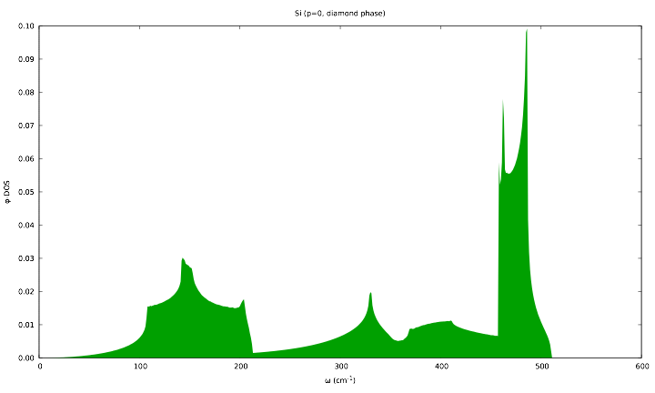
Phonon
Command:
$ pw.x < Si.scf.in > Si.scf.out
$ ph.x < Si.ph.in > Si.ph.out
$ q2r.x <Si.q2r.in > Si.q2r.out
$ matdyn.x <Si.matdyn.in > Si.matdyn.out
Step 1: SCF calculation (Hands-on #1)
Step 2: Calculation of dynamical matrices on q-vectors
Step 3: Calculation of IFC's in real space
Step 4: A plot of the phonon DOS
Si.matdyn.in
(*.exe for Windows users)
&input
asr='simple',
dos=.true.,
amass(1)=28.0855,
flfrc='si.fc',
fldos='si.phdos',
nk1=50,nk2=50,nk3=50,
/
Interatomic force constants (IFC’s) in real space
Data file of phonon DOS
Command:
$ gnuplot < si_phdos.gnu

Slide 75
Exercise #2
Do it by yourself: Graphene’s calculation!
Charge density (rho)
Density of states (dos)
Band structure (bands)
Files for exercise
/graphene/
scf
ecut
k-point
vc-relax
rho
dos
Hands-on #2
bands
phonon

Slide 76
