Slide 1

Berkenalan dengan Universitas Tohoku
Introduction to Tohoku University
Riichiro Saito
Professor, Department of Physics,
Tohoku University
Material presentasi : A. R. T. Nugraha
Tata letak dan bahasa : Retno Ninggalih
Update dan sentuhan akhir : E. H. Hasdeo
Tanggal selesai produksi : 29 October 2013

Slide 2
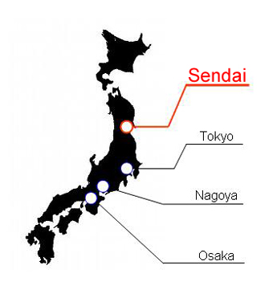
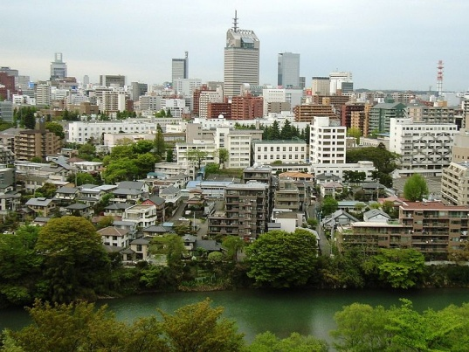
Sekilas tentang Sendai
Sendai at a glance
Lokasi Location
Ibukota Prefektur Miyagi
Capital of Miyagi Prefecture
350 km dari Tokyo
1 jam 35 menit
dengan Shinkansen
Populasi Population
1,031,704 (data 2008)

Slide 3

Sekilas tentang Sendai
Sendai at a glance

Slide 4
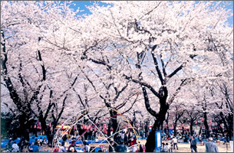
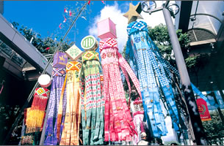
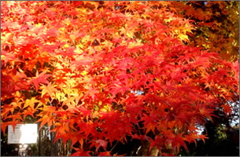
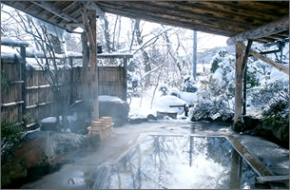
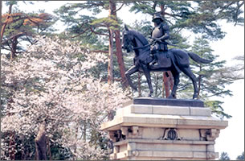

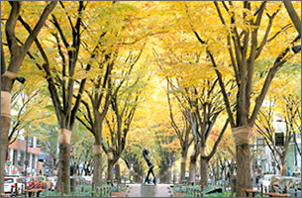
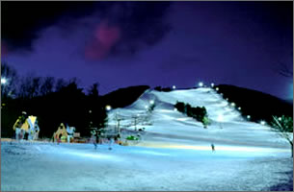
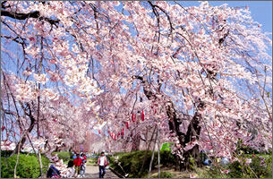

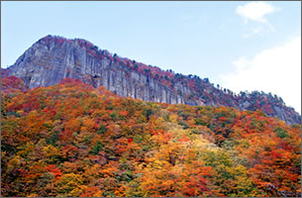
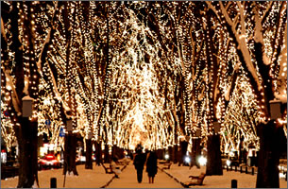
Sekilas tentang Sendai
Sendai at a glance
10 ~ 20 ºC
20 ~ 35 ºC
5~ 15 ºC
-5 ~ 6 ºC
Kaya akan keindahan alam dan pertunjukan menarik
Lots of natural beauty and wonderful attractions

Slide 5
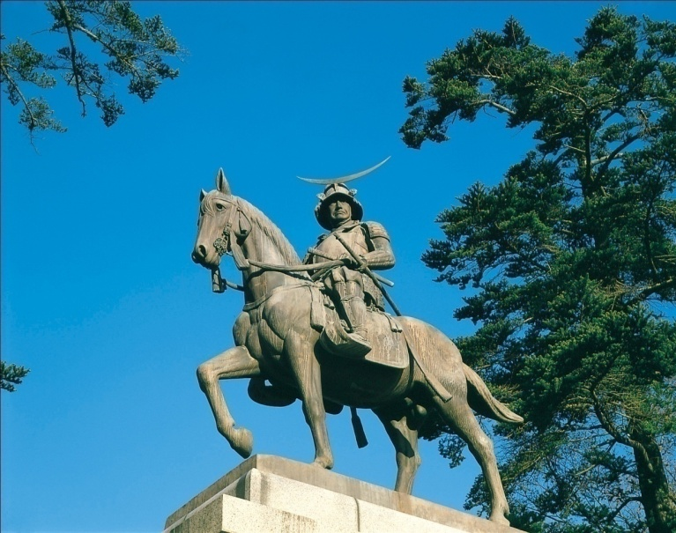
Sekilas tentang Sendai
Sendai at a glance
Date Masamune
Aoba Castle
~ 400 tahun lalu, Date Masamune membangun Aoba Castle
about 400 years ago, Date Masamune built Aoba Castle
Aoba castle terletak di dekat salah satu kampus Tohoku
Aoba castle is located near one of Tohoku University campuses

Slide 6
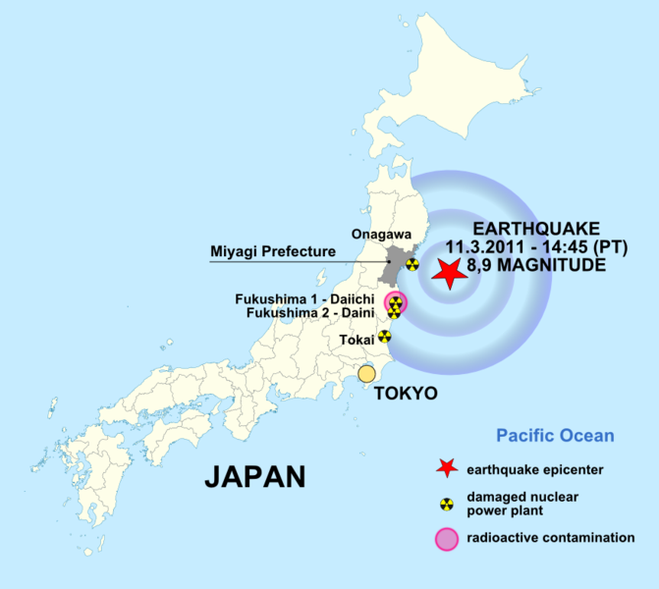
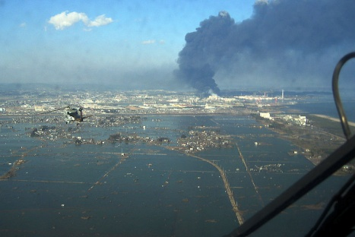
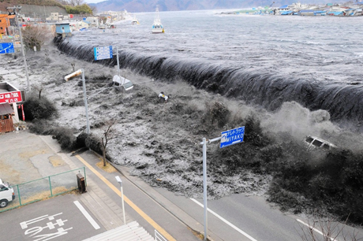
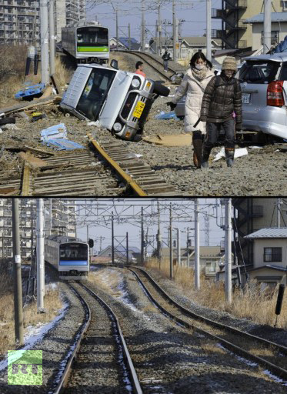
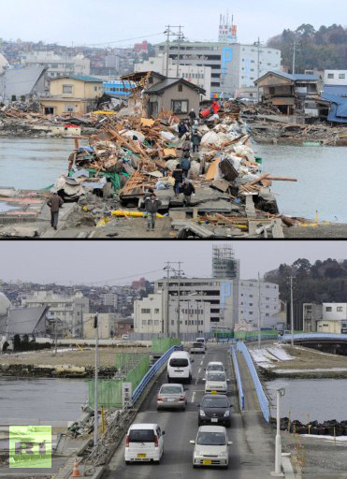
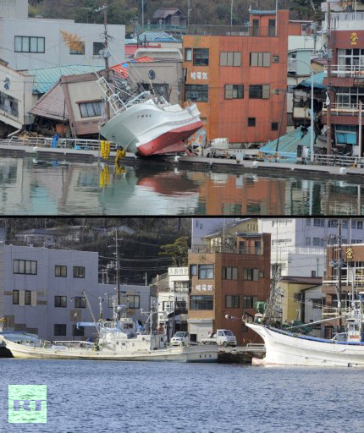
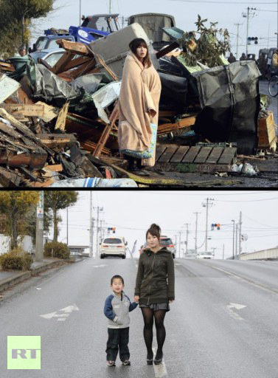
Gempa Tohoku
Tohoku Earthquake
Gempa dan tsunami 11 Maret 2011
Telah pulih selama kurang dari 11 bulan
We have recovered from earthquake and tsunami just after 11 months

Slide 7
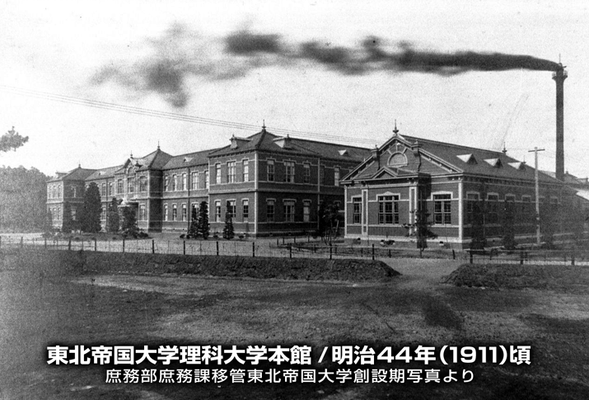
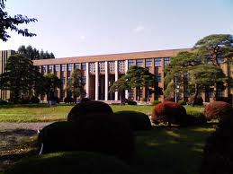
Pendirian Universitas Tohoku
Tohoku University Establishment
Tohoku University (1911)
Kampus Katahira
Didirikan pada 1907 sebagai Universitas Imperial ke-3
Founded in 1907 as the 3rd Imperial University in Japan
Kampus Katahira adalah bangunan kampus pertama
Katahira campus was the first building of Tohoku University

Slide 8
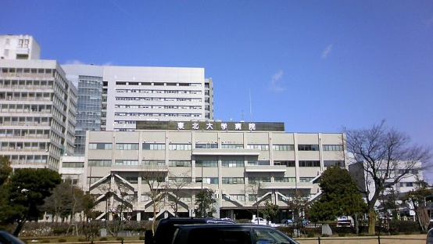
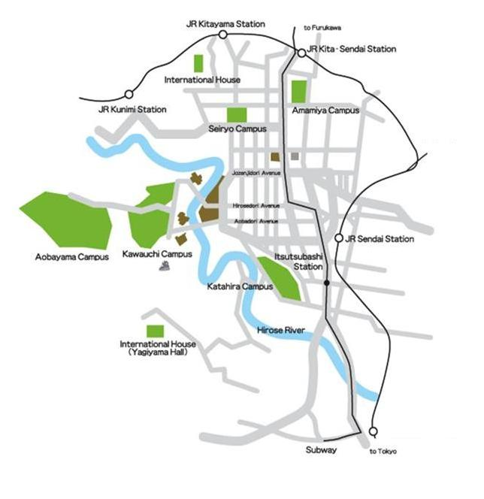
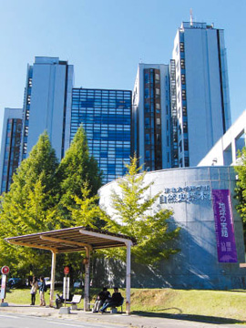
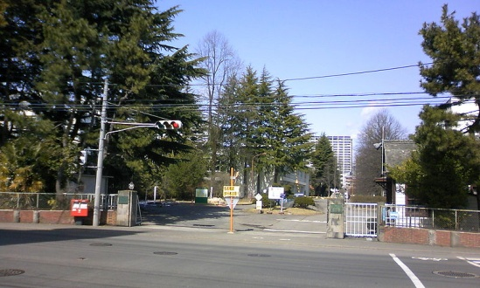
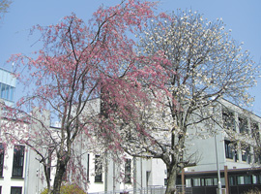
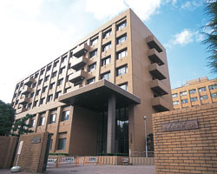
Lokasi kampus di kota sendai
Location of the campuses in Sendai City
Seiryo
5 kampus
Aobayama
Amamiya
Kawauchi
Katahira
Strategis dan dekat pusat kota

Slide 9
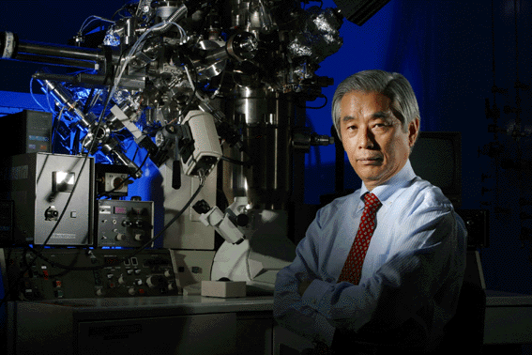
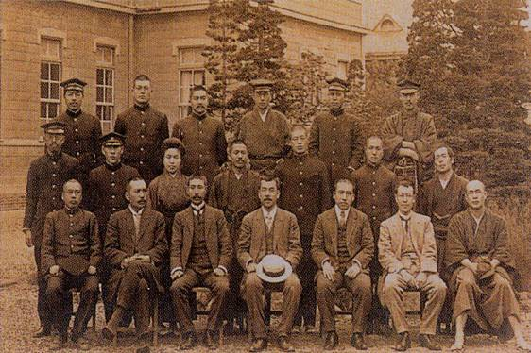
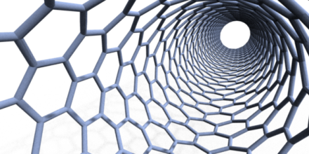
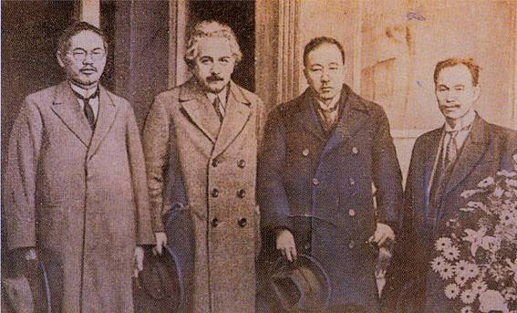
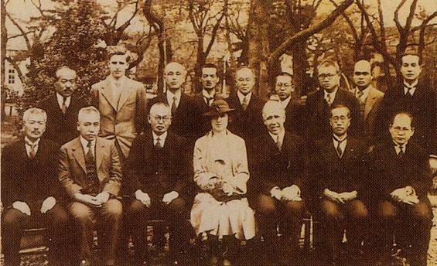
Orang terkenal dalam sejarah U. Tohoku
Famous people in the history of Tohoku University
Sumio Iijima alumni tahun 1968,
penemu carbon nanotube tahun 1991
Chika Kuroda, mahasiswa wanita pertama, masuk 1913
Albert Einstein berkunjung
pada 3 Desember 1922
Niels Bohr berkunjung pada
2 Mei 1937

Slide 10
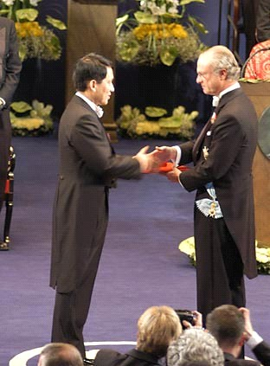
Orang terkenal dalam sejarah U. Tohoku
Famous people in the history of Tohoku University
Koichi TANAKA, Pemenang Nobel Kimia 2002
Nobel Laureate in Chemistry, 2002
“The development of methods for identification and structure analyses of biological macromolecules”
1983 : Lulus (sarjana teknik ) dari Tohoku
Graduated (B. Eng) from Tohoku University
1983 : Mulai bekerja di Shimadzu Corp.
Started work at Shimadzu Corporation
1985 : Merancang soft laser desorption
Developed soft laser desorption (SLD) method
2002 : Nobel Prize
Also awarded Doctor Honoris Causa from Tohoku Univ.
Photo: Nobel e-Museum

Slide 11
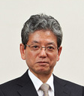
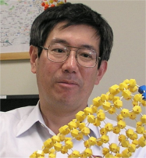
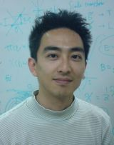
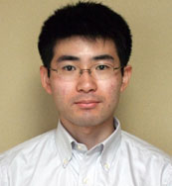
Komposisi staf dan mahasiswa
Number of staffs and students
Jumlah Anggota Dewan Pimpinan dan Staf Number of Board Members and Staffs
Presiden |  | 1
Direktur Eksekutif |  | 6
Auditor |  | 1
Anggota Fakultas (Faculty members) | Profesor.(852) | 2,969
 | Assoc. Profs.(716)
 | Lects.(153)
 | Assist. Profs. (1,117)
 | Research Assoc. (131)
Administrasi dan staf teknis |  | 2,971
Total |  | 5,950

Slide 12

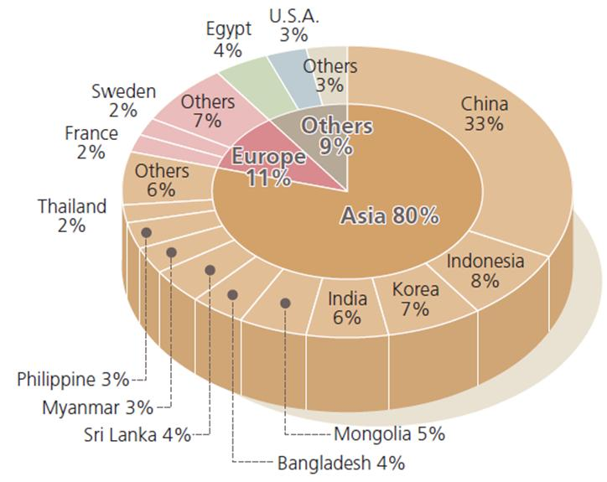
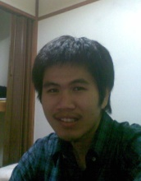
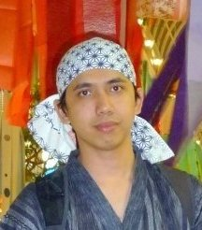
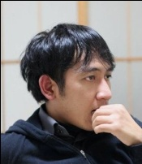
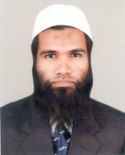
Komposisi staf dan mahasiswa
Number of staffs and students
Jumlah Mahasiswa Number of Students
Jumlah mahasiswa asing berdasarkan kebangsaan
International students by nationality
Strata 1 (Undergraduate) | 10,９６７
Strata 2 (Master) | 4,471
Strata 3 (Doctor) | 2,787
Total | 18,225
Faculty per Students Ratio
1 per 3.9 (Undergraduate)
1 per 2.1 (Graduate)
International Students
1.5% (Undergraduate)
7.3% (Graduate)
(Data 2004-2007)

Slide 13
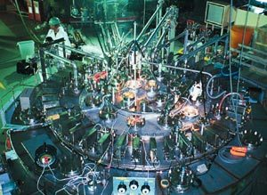
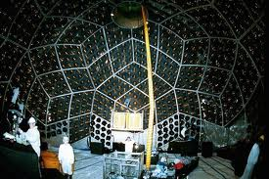
Salah satu rujukan terbaik di dunia one of the top-cited institutions in the world
Pengutipan Makalah Paper citations
Ranking Nasional | Ranking Internasional | Bidang (Fields) | Pengutipan (#Citations) | Paper
1 | 3 | Material Science | 48,269 | 6,201
2 | 12 | Physics | 133,004 | 11,688
6 | 20 | Chemistry | 87,507 | 6,954
5 | 69 | All fields | 512,569 | 45,528
(ISI Essential Science Indicators, 2011)
Nanotube paper:
~ 7,000 citations
KamLAND paper: ~ 10,000 citations

Slide 14
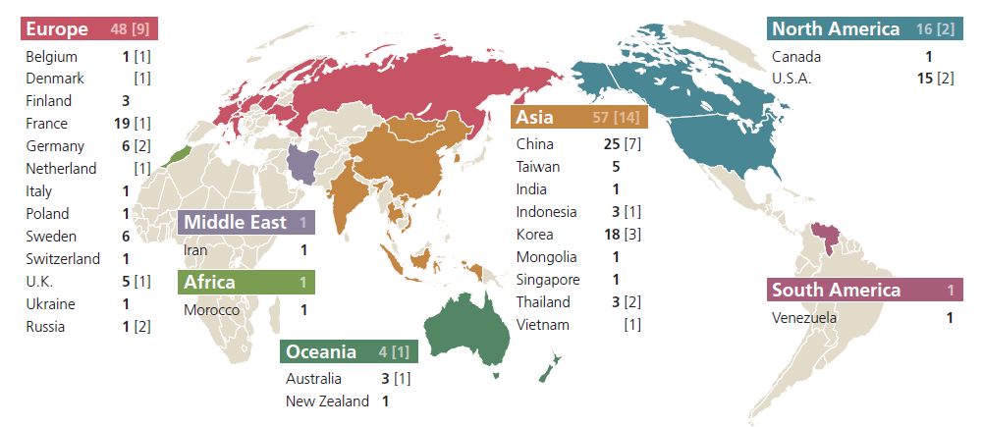
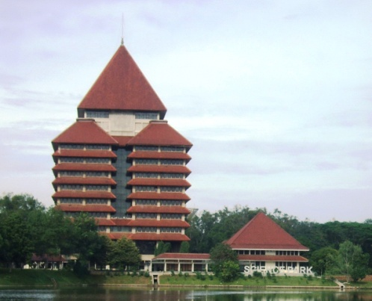
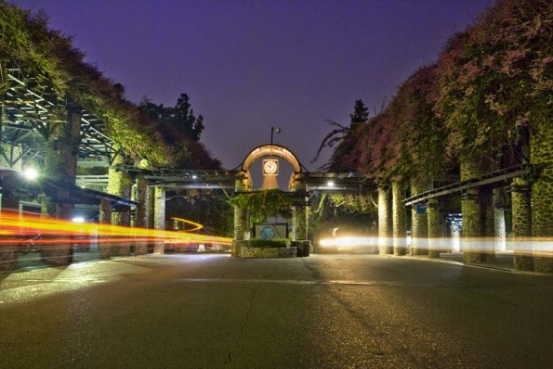
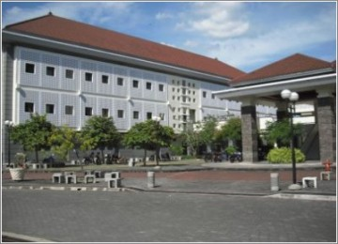
Kerjasama internasional
International agreements
Note that [ ] = deparment level agreements of the Graduate School of Science
4
IPB
ボゴー 農科大学
Universitas
Indonesia
インドネシア大学
ITB
バンドン工科大学
UGM
ガジャマダ大学

Slide 15
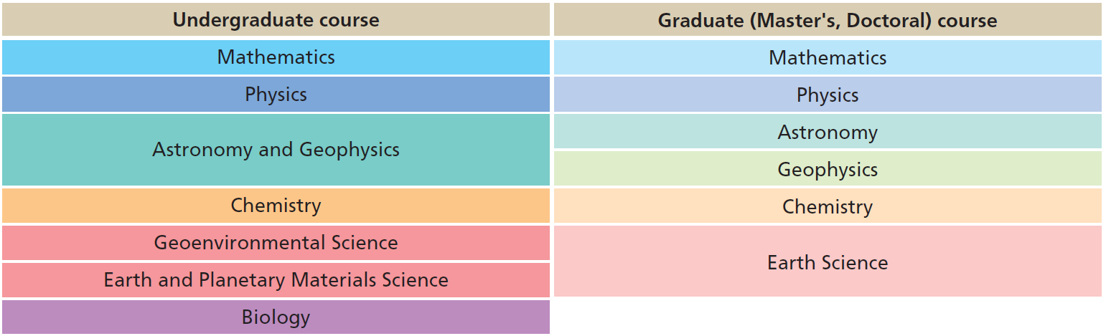




Sekolah Sains
School of Science
Fakultas sains (sarjana)
Faculty of science (undergraduate)
Sekolah pascasarjana sains
Graduate school of science
Aobayama Campus
Memiliki pusat riset kelas dunia (COE)
Equipped with world-class research centers (COE)

Slide 16


Program IGPAS
International Graduate Program for Advanced Sciences
Tahun akademik dimulai setiap Oktober
Academic year starts in October
All are in English!
Pendaftaran: satu tahun sebelum masuk program
Application : one year before the course starts
Dipilih: 20 Master dan 4 Doktor
16 Master students and 4 Doctor student will be selected
Pendaftaran (Application)
Program Flowchart
Ujian masuk
(Entrance exam)
Program master
(M.Sc degree)
Pendaftaran (Application)
5 yrs
2 yrs
Penyaringan kembali
(Screening)
Ujian masuk
(Entrance exam)
Program doktor
(Ph.D degree)
3 yrs

Slide 17

Program IGPAS
International Graduate Program for Advanced Sciences
Tahapan pendaftaran (Application flowchart)
1st step, by November, start to contact and communicate with a host professor

Slide 18




Cara mengontak profesor
How to contact a professor
Perkenalan
(Introduction)
First of all…
Pastikan bidangmu cocok!
Make sure that your research interests match the professor’s field
Motivasi
(Motivation)
Rencana riset
(Research plan)
Jangan lupa sertakan CV + foto
Don’t forget to attach CV with photo

Slide 19


Dukungan dana untuk mahasiswa
Financial support for students
http://www.sci.tohoku.ac.jp/english/igpas/
Mahasiswa IGPAS dibebaskan dari
biaya masuk dan SPP
IGPAS students are exempted from admission and tuition fees
Beasiswa (Scholarship)
Monbusho (MEXT) Scholarship
Other scholarships
Available for 20 IGPAS students
e.g.
146,000 yen / bulan (master)
147,000 yen / bulan (doktor)
Government
JSPS Fellow
Self Financed?
200,000 yen / bulan (doktor)
362,000 yen / bulan (Post. Doc)
Bea hidup (living cost): 80,000~150,000 yen

Slide 20










Bidang riset di departemen fisika
Research groups
Silakan cek: www.phys.tohoku.ac.jp
Fisika Partikel Teoretik
(Particle Theory)
2 grup
(7 profs)
Fisika Partikel Eksperimental
(Experimental Particle Physics)
6 grup
(15 profs)
KamLAND
Project

Slide 21



Bidang riset di departemen fisika
Research groups
Teori Material Termampatkan
(Condensed Matter Theory)
2 grup
(6 profs)
Fisika Material Eksperimental
(Condensed Matter Experiment)
24 grup
(30 profs)

Slide 22










Grup fisika material teoretik
Theoretical condensed matter and statistical physics group
Grup Prof. Riichiro Saito (Carbon physics)
Graphene,
Graphite
Carbon
nanotubes
Theoretical
spectroscopy

Slide 23




Belajar dan penelitian di Jepang
Study and research in Japan
Mahasiswa Jepang = pekerja keras
All students in Japan are hardworker
Malas awal kegagalan
If you are lazy, 99% you’d be failed
Studi doktor sangat berat dan melelahkan

Slide 24
Rangkuman presentasi
Summary
Tohoku University: 3 besar
universitas top di Jepang
Sendai (1 juta penduduk):
Biaya hidup relatif murah (cheap)
Banyak pelajar Indonesia (~80 orang)
Graduate School of Science
IGPAS course
Beasiswa Monbusho
5 tahun, ~Rp 15 jt / bulan
Ranking 12 dunia untuk Fisika
Kontak profesor sekarang juga!
Please also fill out the questionnaires. ☺
Sendai
Katahira
Kawauchi
Aobayama
Amamiya
Seiryo

